Slide 1
Part IV: Applications
1
9 -
Notes:
Thus far, we have examined in-depth how to go about seasonally-adjusting your data, for both monthly data & daily data. The focus has been on the process of developing seasonally-adjusted numbers that will allow you to learn more from your data. Well, now that you can seasonally-adjust your data, what do you do with it? That’s where we turn now in Part IV. We will look at how to apply the information gained from the seasonal adjustment process. We’ll start by taking a quick look at reporting, then examine how to use the results to go about estimating your price elasticity. We will also look at retention, and of course, at forecasting. For the most part, the applications will focus on monthly performance, rather than daily. But most of the guidance here can equally well be applied to analysis of the daily data.

Slide 2
Chapter 9: Reporting
2
9 -
Notes:
In this chapter, we look at monthly reporting.

Slide 3
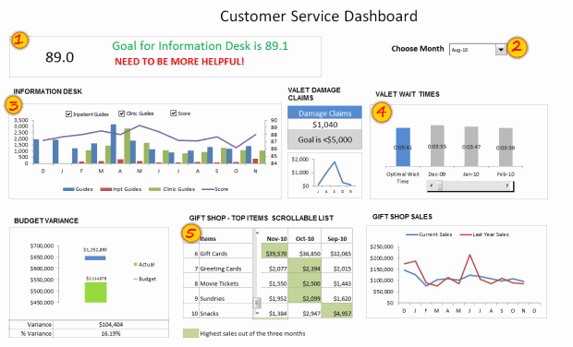
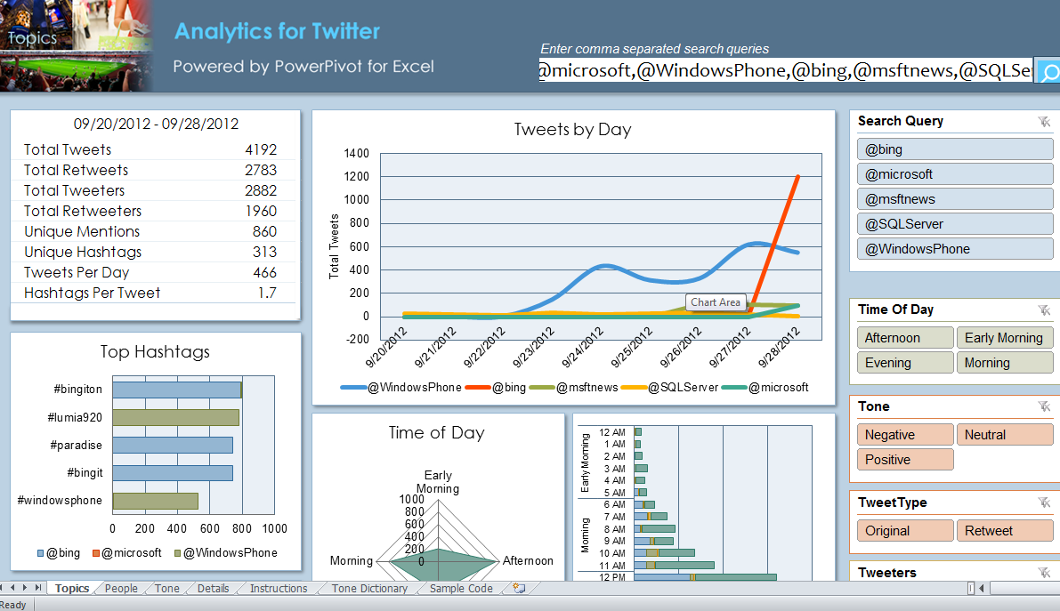
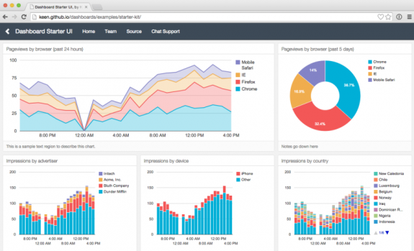
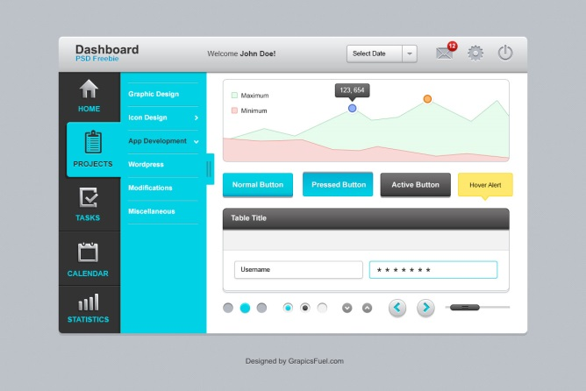
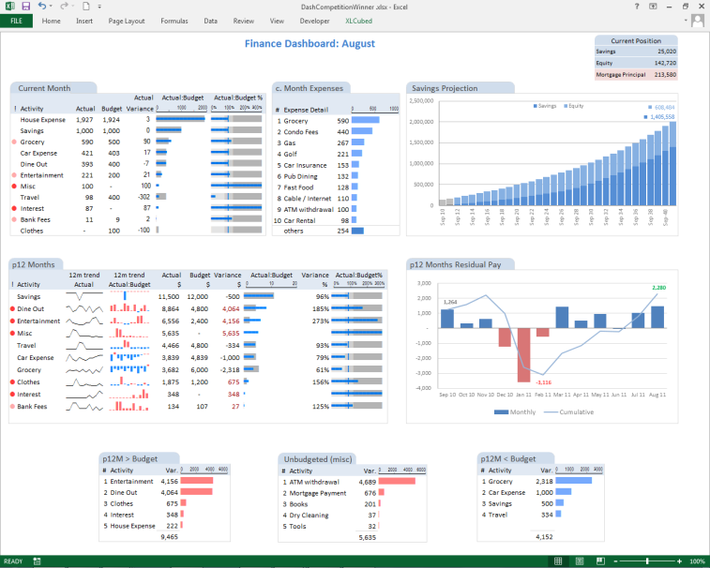
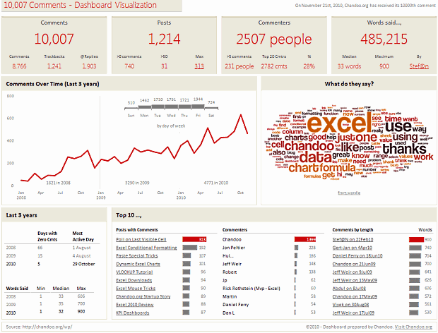
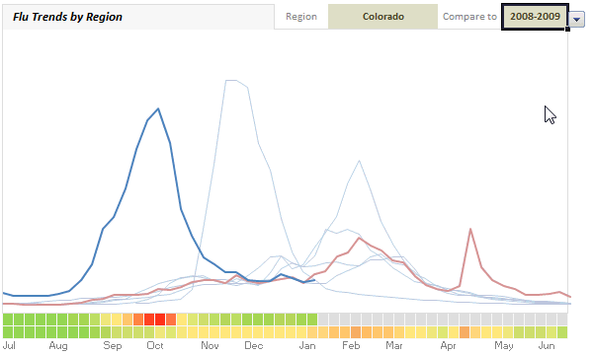
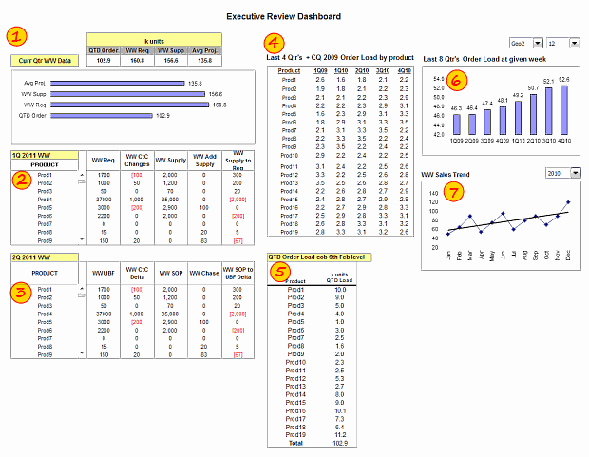
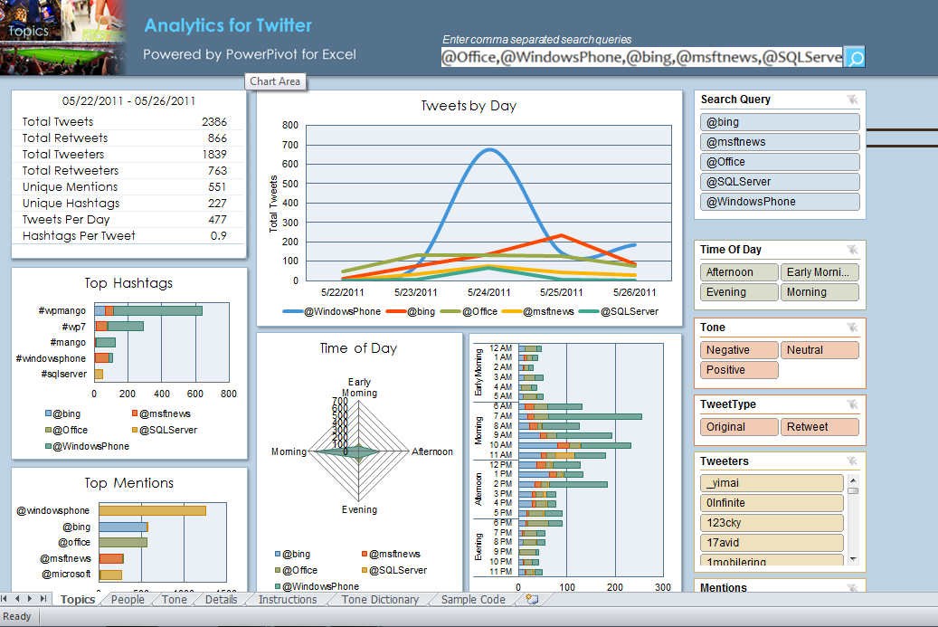
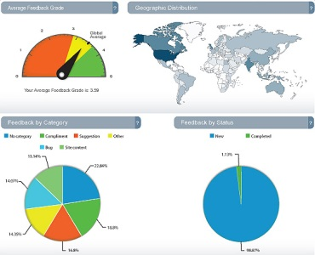
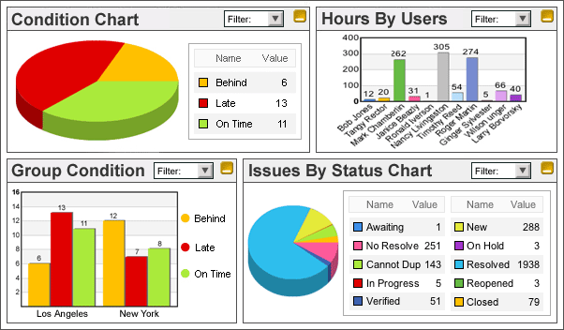
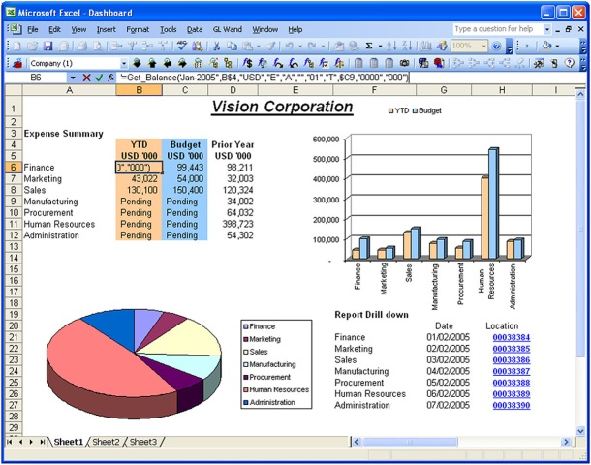
Reporting
This chapter will briefly review what to present in reports, rather than on how to present it.
Introduction
3
9 -
Notes:
The focus of this chapter will be on what to present in your reports, not how to present it.

Slide 4
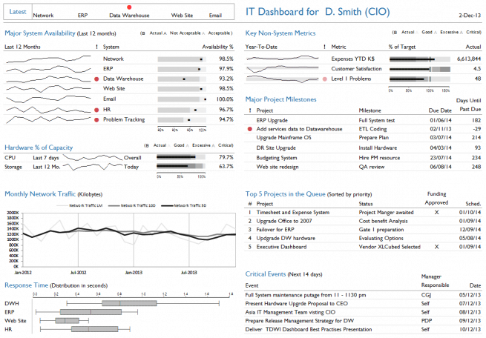
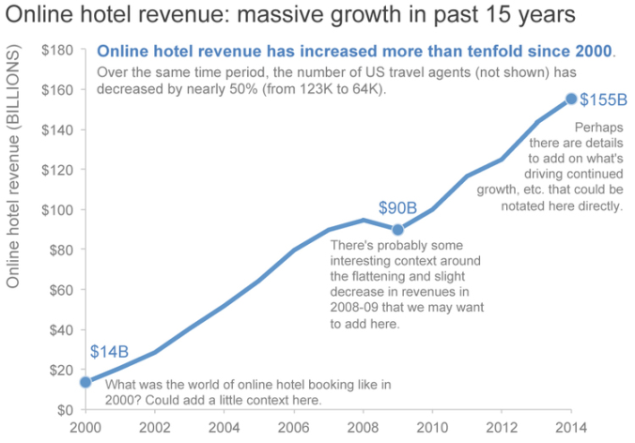
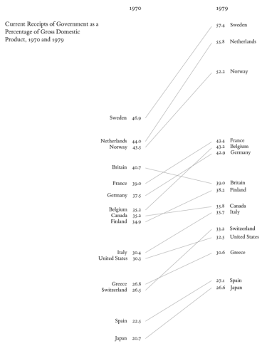
Reporting
There are numerous excellent resources for guidance on how reports & charts should look, and not look.
Stephen Few
Cole Nussbaumer Knaflic
Chandoo.org
Edward Tufte
4
9 -
Notes:
There are numerous excellent resources to refer to for ideas on how to present your data, and I highly recommend you’re looking at them. Stephen Few is a master at focusing on what to present and how to present it, with emphasis on only showing what is necessary and excluding everything else. Cole Knaflic has an excellent book on Storytelling with Data that helps show how to walk through the presentation of your data so that your audience isn’t overwhelmed, and instead well understands your message. Chandoo.org is a website with all manner of info on using Excel. His site, and audience, have numerous helpful suggestions on keeping reports clear and simple, as well as advice on how to perform the appropriate analysis in Excel. Edward Tufte of course is often referenced as a classic guide on presenting data.

Slide 5
Reporting
Answering the question, “how are you doing?”, requires three fundamental elements:
Current Level
Current Growth Rate
Recent Events
5
9 -
Notes:
What I want to focus on here is what you include in your report. Here I go back to where we began: what is the purpose of a report? I would argue that ultimately the primary purpose of a report is to answer the question, “how are you doing?”. That answer not only gets at where your business is at now, but would also speak to how well a given recent initiative is performing, or where your business appears to be headed. The answer to the question, ”how are you doing?”, involves three critical elements.
1st, it requires being able to quantify the approximate level you are at today, for your given metric. 2nd, it involves providing what your approximate growth rate is, or what the current slope is for your data set; this can be very difficult to determine, even when looking at the past, but this trend model will include your current growth rate estimate. 3rd, it entails identifying and quantifying any recent events, occasions where a step function up or down has occurred. Combine these three elements, and you have provided a clear picture of how you are doing. And by knowing how you’ve done in past, and where you’re at today, you are in a much better position to postulate on where you’re headed.

Slide 6
Reporting
All three key reporting elements can be found on the “Trend” tab, with the current level being read from the chart’s Estimated Trend line.
2. Current Growth Rate
Forecast Period
3. Recent Events
23.5
1.
Current Level
Trend Model: Trend
6
9 -
Notes:
All three of these key reporting elements are found on your “Trend” tab of the Trend Model file. The current level you’re at can be read from the chart. It is quite simply the value of the estimated trend for the current month. Here, as of January 2017, the current level is approximately 23.5 billion shares per month. Your current growth rate is the Growth Rate you’re using in your model for the current month, so in this example taken at the end of January 2017, the current growth rate is the 1.0% we find located in Cell S13. Finally, recent events are of course, those you’ve input in the Events section of the worksheet. Here we have placed a 1-time spike (& reversal) in Nov 2016.
It could be that you’d like to have this “Trend” tab explicitly display all these 3 elements. While I haven’t done so here, it would be easy for you to use a given set of cells or columns to display this vital info. Such info could be displayed at the top of the worksheet, perhaps immediately above the chart.

Slide 7
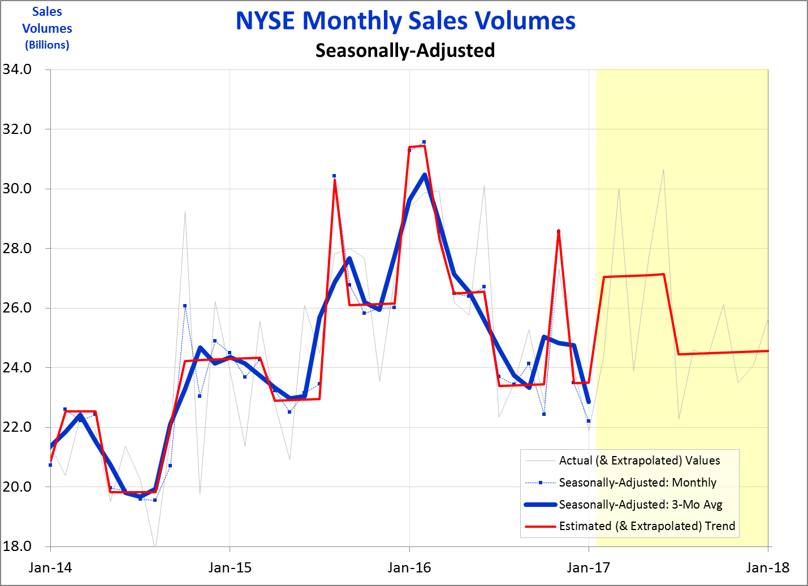
Reporting
The “Trend” tab’s chart can very effectively allow your audience to “see” how you’re doing.
Forecast Period
Trend Model: Trend
7
9 -
Notes:
The chart on the “Trend” tab certainly offers a very effective way of allowing your audience to “see” how you are doing. When first presenting this information, I would recommend you slowly walk through each line, just as I did back in Chapter 6. So, show them a blank chart with just the two axes, then insert the actuals, then the seasonally-adjusted line, then its 3-month moving average, and then finally your estimate of trend.

Slide 8
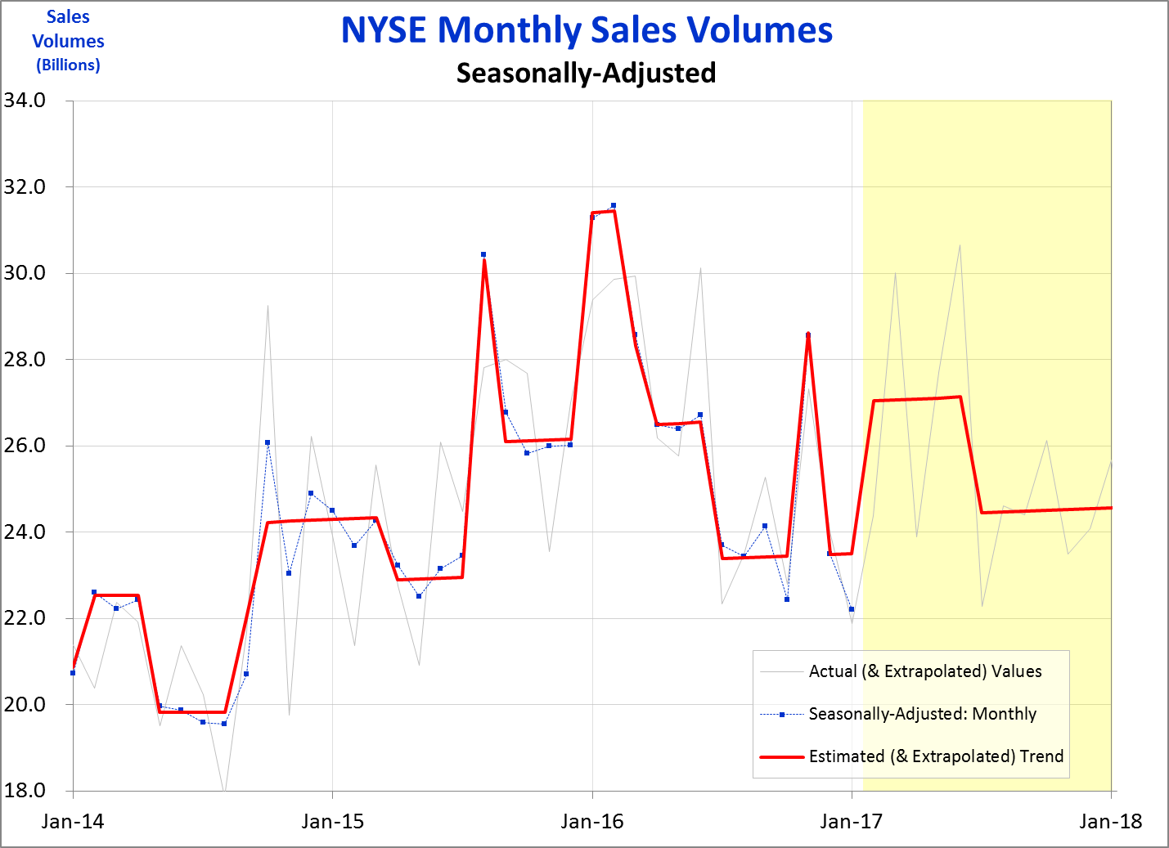
Reporting
A summary chart might exclude one or two of the lines used in the “Trend” tab, and would likely show some forecast period.
Forecast Period
Trend Model: Trend
8
9 -
Notes:
You’ll want to give careful thought to whether all these lines are necessary. It could well be that your audience is better served to have one of the seasonally-adjusted data lines removed, and perhaps the actuals aren’t necessary. However, keep in mind that your forecasts are only going to have two versions – the trend, as indicated by the red estimated trend line in the example here, and the forecast actuals, indicated by the light grey line. There is no difference between your forecast trend line and a forecast of the seasonally-adjusted data. We’ll be getting into forecasts much more in a later chapter.

Slide 9
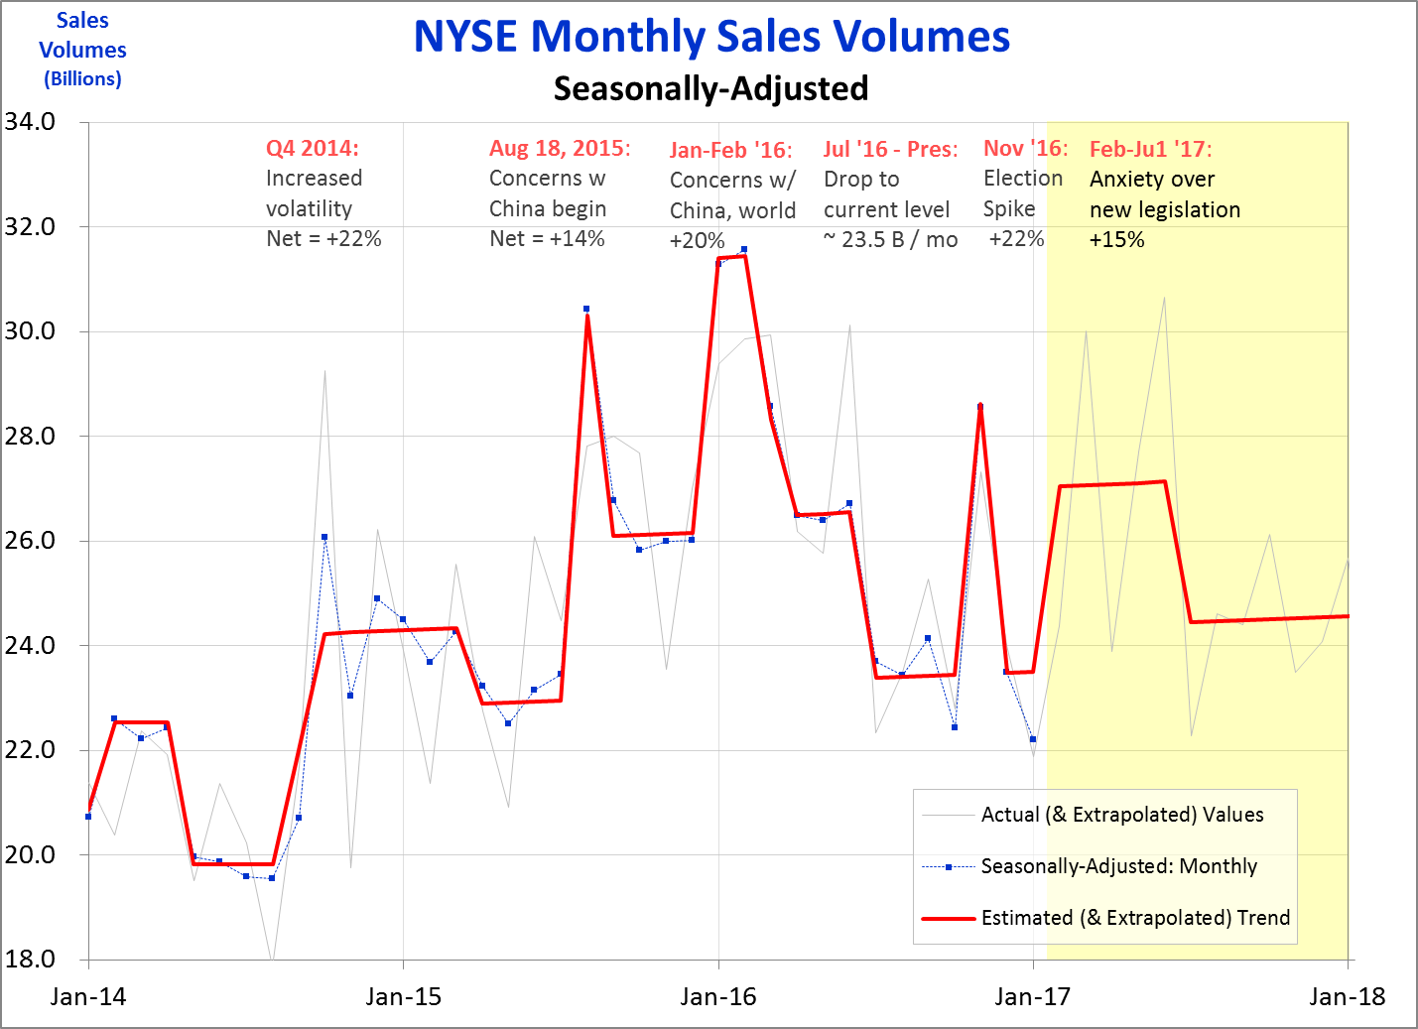
Reporting
The trend chart can be supplemented with info describing past, and future, events.
Trend Model: Trend
9
9 -
Notes:
Your trend chart can also be used to call out specific events – what they are, and your estimate of how large they were, or will be. In this example, I’ve chosen to describe certain events that resulted in significant rises or drops in sales volumes. Unfortunately, my lack of inside knowledge of this industry leaves me poorly prepared to give better explanations for the data behavior. I would trust an industry analyst would offer better explanations, and provide better forecasts. The forecast here is obviously all about demonstrating how a forecast trend might be presented.

Slide 10
Reporting
One of the most valuable outputs of this seasonally-adjusted trend model is the identification and measurement of events.
Trend Model: Trend
10
9 -
Notes:
I’ve mentioned it frequently before, but I think it still bears repeating, one of the most valuable aspects of this trend model is its identification and quantification of the events, or step functions, that occur with virtually any given metric. Most of the time, these events are the drivers of what makes your performance change over time – for better or worse. When you see and quantify an event, you must ask yourself why?, what is causing this sudden change to occur. You may know from what you’ve heard around your organization, or you may need to do some research to ferret out the answer. But by using this model, you should be the very first person aware that an event has occurred, and have in hand a good estimate of the amount of impact.

Slide 11

Reporting
Your independent measurement of events can provide a helpful validation – or perhaps an alternative result – to estimates others have made.
Our latest ad campaign got a 10% lift!
Um,… actually we think it may be closer to about 7%.
Marketing Department
Financial Analysis
11
9 -
Notes:
Of course, there will no doubt be occasions when you come up with estimates for an event that differ from estimates developed by another department. With all due respect to Marketing departments, I’ve never known one to come up with an estimate for the impact of a marketing campaign that is smaller than the estimate I’ve derived. On the other hand, there will also be occasions where your estimates closely match those from others, in which case it provides a validation of your estimate, and theirs.

Slide 12
Reporting
Event measures can be made on numerous types of drivers of step functions.
Ad campaigns
Promotions
New products
New processes
New regulations
Competitive activity
Natural disasters
Good (or bad) press
Etc., etc.
and … price changes
12
9 -
Notes:
There are all sorts of events that you’ll find need measurement. Internally, these can be anything from ad campaigns & promotions to new products or processes. External factors can cause a sudden shift, be it from new regulations or the activity of a major competitor, or natural disasters or good or bad news in the press. Hopefully you design your reporting in a way that you clearly show when the event took place, what the event was, and your estimate of its amount.
One special kind of event merits attention all its own: the impact of price changes, to which we turn next….

