Slide 1
Chapter 8: Estimating Trend Daily
1
8 -
Notes:
Now that we have the DOM factors, we’re ready to move on to estimating trend on daily data. A warning up front. This is a challenging process. Daily data will inevitably display much volatility, even after adjusting the data for numerous predictable day-to-day variations. Inserting moving averages is going to help with this process, as will being able to observe month-to-month differences between actuals and your estimate of trend.
Throughout the process of estimating trend daily, keep in mind its purpose: to inform & explain data behavior, to provide timely awareness & accurate measures of sudden data shifts, and to learn from past experience so that future performance may be improved.

Slide 2
Estimating Trend Daily
Introduction
Model Set-Up
Estimating Trend
Low Factor Adjustments
Key Points
This chapter will examine how you go about estimating trend on a daily basis.
Introduction
Model Set-Up
Estimating Trend
Low Factor Adjustments
Key Points
Introduction
2
8 -
Notes:
This chapter is roughly divided into five parts. We start with an introductory overview, then describe in some detail, how the model is set up. We then walk through the process of estimating trend; follow that with a discussion of “Low Factor Adjustments” that are a part of the model to help avoid the undue and disproportionate impact of seasonally-adjusting data when certain days find themselves with unusually low factors, such as may occur immediately following a major holiday. And we conclude with a summary review of key points from this chapter.

Slide 3
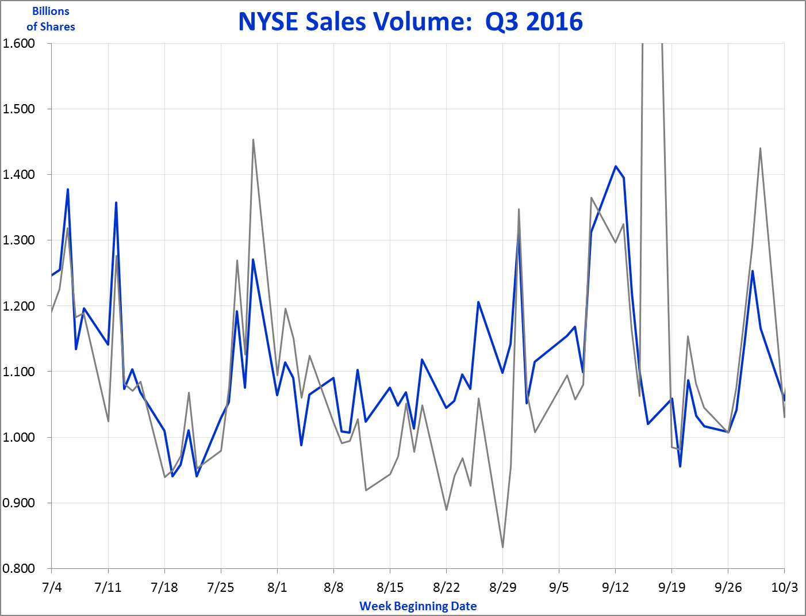
Estimating Trend Daily
Introduction
Model Set-Up
Estimating Trend
Low Factor Adjustments
Key Points
Perhaps the greatest challenge with estimating daily trend is the substantial volatility in the data, even after normalizing.
Original
Normalized
3
8 -
Notes:
One of the greatest challenges of dealing with daily data is its inescapable volatility. There’s always going to be substantial fluctuations due to all manner of causes.

Slide 4
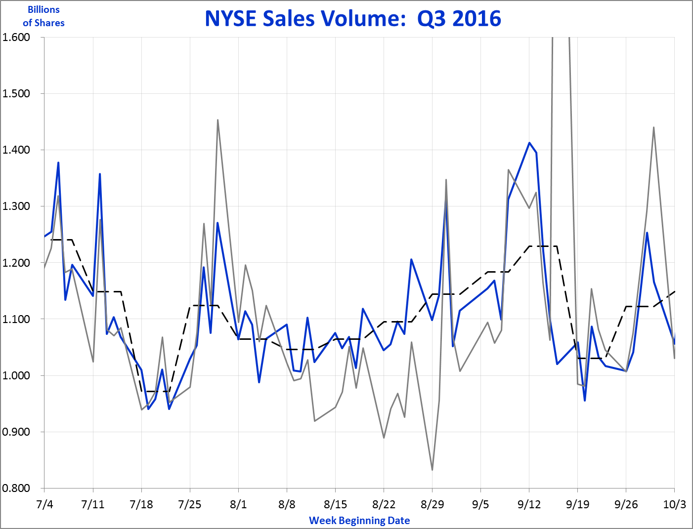
Estimating Trend Daily
Introduction
Model Set-Up
Estimating Trend
Low Factor Adjustments
Key Points
Swings in the data occur both day-to-day, and week-to-week.
Original
20%+
Day-to-Day swing
Calendar
Week Average
15%+
Week-to-Week swing
Normalized
4
8 -
Notes:
While normalizing the data – for the day of the week, holidays, day of the month, etc. – can help reduce it, there will still remain a substantial amount of volatility. Daily fluctuations occur for a vast amount of reasons, some of which may be explicable, and some that are just simply the inevitable “noise” of any given data set. Even the explicable reasons for daily fluctuations may not merit trying to track and measure, simply because they may not provide much helpful insight and the effort just isn’t worth the payback. But if you’re in a highly competitive industry, and you’re accustomed to tracking & reporting data daily, then you still need to grapple with this volatility. Hopefully the levers and elements provided by this model, and described in this chapter, will help you better cope with this frustrating aspect of the data.

Slide 5
Estimating Trend Daily
Introduction
Model Set-Up
Estimating Trend
Low Factor Adjustments
Key Points
Many variable characteristics of the calendar need to be considered in order to correctly normalize the daily data.
Month lengths
Weekends (if closed)
Holiday dates
Easter
Unplanned “holidays”
Extra short months
Year length
Leap year
5
8 -
Notes:
It’s easy to think of daily data as simply a collection of 365 daily data points over the course of the year. But to try to work with so many individual data points, in just one year alone, would be overwhelming. Inevitably, we will want to break the data up into pieces to some extent. In particular, we will want to think & work in terms of the month of the year: the months are generally the most important time period that is reported on and acted upon. Daily data is noisy, and rounding it into its monthly components helps summarize the data.
But the calendar is fickle, and its helpful to be reminded of what makes it so difficult to work with. The calendar months are of different lengths, varying from 28 to 31 days. If a business is closed on weekends, month lengths vary even more, from between 18 to 23 business days. Holidays interrupt the flow of data, causing various temporary slowdowns (or upticks) across the year. Easter can be rather nettlesome because its timing changes each year, and crosses two calendar months. Unplanned holidays can occur, where business suddenly and dramatically changes for a few days due to events that are outside our ability to control – natural or manmade disasters, for example. Sometimes month lengths can be especially short, such as, for example, when businesses like the NYSE are closed for Good Friday, and in a month when there are already 5 full weekends accounted for. Leap years make for a longer year obviously with the extra day added, a day which makes February a little less reliable a unit of time to examine. And year lengths vary not just because of the leap year, but because having a year of 365 (or 366) days length means that one (or two) days of the week occur 53 times, not just 52.
In short, the design of our calendar is part and parcel of why trend series data can be difficult to analyze – there are just so many aspects of the calendar itself that automatically builds in a certain level of irregularity to the data. So be it; we’ll do our best regardless.

Slide 6
Estimating Trend Daily
Introduction
Model Set-Up
Estimating Trend
Low Factor Adjustments
Key Points
The “Daily Trend Model” has three sections:
“Inputs” tab
“Calc” tab
Annual Trend tabs
Model Set-Up
6
8 -
Notes:
We start with the development of the Daily Trend Model. This model can be found on the website; it is labeled “DailyTrendModel”. The model here tracks the NYSE. You can use this model for your own data, by simply overlaying your own data onto it: replace the daily data with your own, and replace the various daily factors with your own. If you have fewer years of data – this model goes back to 2011 – delete or erase the extra unneeded years. If you have more years, add those on, using the existing model here as guidance.
The DailyTrend Model has three tabs, which we will walk through individually. The “Inputs” tab brings in all the key factors we’ve developed – EDFs, DOMs, etc. The “Calc” tab handles virtually all the calculations. The “Trend” tabs are where the trend is estimated. But because we are dealing with so much data, the tabs are divided by year, with one tab for each year. So this model has 10 different “Trend” tabs, one for each year between 2011 and 2020.

Slide 7
Estimating Trend Daily
Introduction
Model Set-Up
Estimating Trend
Low Factor Adjustments
Key Points
The “Inputs” tab brings in all the factors that influence the relative level of activity across the days of the week, month, & year.
DailyTrendModel: Inputs
Model Set-Up: “Inputs”
7
8 -
Notes:
As mentioned, the “Inputs” tab brings in all the various factors we’ve developed for describing the data. Let’s walk through it.

Slide 8
Estimating Trend Daily
Introduction
Model Set-Up
Estimating Trend
Low Factor Adjustments
Key Points
The top of the page imports all the previously developed daily and holiday and monthly seasonal factors.
DailyTrendModel: Inputs
8
8 -
Notes:
The top of the “Inputs” page has all our previously developed factors related to the daily data. These factors were previously developed to determine more precisely the “true” length of each month. Now they will be used to adjust each day’s volumes to account for the day of the week, the influence of holidays, as well as the relative busyness of their calendar month. The Daily Trend Model we’re using here will only be for the period 2011-forward, so arguably the factors shown here for earlier periods will of course not be used. But they’re left here, partly as it is easier to just bring in the whole set as is, but also because when it comes time for you to insert your own data and results, you may well want to have the additional placeholders to work with.

Slide 9
Estimating Trend Daily
Introduction
Model Set-Up
Estimating Trend
Low Factor Adjustments
Key Points
We will want the Day of Month (DOM) Factors to be available in a format that meets two criteria.
Easy to use
– all formula
Handles Changing Month Lengths
9
8 -
Notes:
The DOM Factors, that we developed in the last chapter, measure the activity on a given day of the month relative to a daily average across the month. They tell us how much more busy or quiet each day is simply because of where it is placed during the month; and we noted how there can often be an uptick in activity at month’s end, especially when dealing with sales. We are now going to want to apply those factors, and in doing so, we want to do it in a way that’s easy to use. In other words, we’re going to want to be able to apply them all by formula alone, without having to insert or move factors around manually. (Not only would manual shifts be cumbersome and time-consuming, they can easily be done incorrectly.) We also want to make sure that the factors are applied appropriately, given the changing month lengths. For example, while March can be as long as 23 days (assuming business is closed at the weekends), it can have only 22 days or 21 days if there are 5 Saturdays or 5 Sundays or both, in the month. And then, because we’re using the NYSE sales volumes example, we find that occasionally there are only 20 business days in the month – this occurs when there are 5 full weekends, and when the Good Friday holiday falls during the month of March. We want to set up the DOM Factors in the “Inputs” tab in such a way that these two criteria are met – that they are easy to use, and that they appropriately handle the changing month lengths.

Slide 10
Estimating Trend Daily
Introduction
Model Set-Up
Estimating Trend
Low Factor Adjustments
Key Points
The monthly DOM Factors developed in the last chapter are brought in, sorted without the missing days in the middle.
DailyTrendModel: Inputs
10
8 -
Notes:
We start out with the monthly DOM factors we developed in the last chapter. Notice that the “missing” days in the shorter months, like January, are now placed at the bottom. We had previously placed the missing days in the middle to ensure every month appropriately ended strong on the final day. Now we have the missing days back at the bottom because it will be much easier to pick them up when we come to apply them in the Calculations tab. Note that the 11th day in January is shaded pink. This is to draw attention to the fact that the formula skips here. The 10th picks up the value from the 10th day in the DOM Factor file, but the 11th picks up the formula from the very next day of activity, which for January happens to be from the 13th row in the summary DOM Factors table.

Slide 11
Estimating Trend Daily
Introduction
Model Set-Up
Estimating Trend
Low Factor Adjustments
Key Points
Additional source tables need to be developed for when months have a shorter length.
DailyTrendModel: Inputs
11
8 -
Notes:
Next we begin to address the varying lengths of the months. Here we have added in a table for what are called the “Medium Length Months”; these are the months where there is one extra Saturday or one extra Sunday. Note that we’ve hidden the months of April thru October in the tables here in order to be better able to see what’s going on.

Slide 12
Estimating Trend Daily
Introduction
Model Set-Up
Estimating Trend
Low Factor Adjustments
Key Points
The different month lengths are identified in the “Inputs” tab.
DailyTrendModel: Inputs
12
8 -
Notes:
The tables are labeled to identify the length of the month. The 1st table has the “long” months; the 2nd table has the “Medium Length Months”. They are so labeled at the top. And, in Row 127, they are given the number “1” for “Long” months and the number “2” for “Medium” months. These values will later be used in array formulas to enable picking up the appropriate set of factors.

Slide 13
Estimating Trend Daily
Introduction
Model Set-Up
Estimating Trend
Low Factor Adjustments
Key Points
The shorter months pick up the values from the original “Long Month” table, dropping the day(s) in the middle.
DailyTrendModel: Inputs
13
8 -
Notes:
Next we shorten the month length by picking up the values from the original “Long” month table. Note however that the 2nd table drops the day in the middle. Thus, for March, it picks up the 1st 11 days of the month, and the last 11 days of the month; the value for the 12th day is left untouched.

Slide 14
Estimating Trend Daily
Introduction
Model Set-Up
Estimating Trend
Low Factor Adjustments
Key Points
Because we are dealing with indices, we want to make sure that the total for the factors always exactly equals the number of days.
DailyTrendModel: Inputs
14
8 -
Notes:
The DOM Factors are factors, indices that measure the relative length of each day. Because these are indices, we want to make sure they always add up to exactly the number of days that we are dealing with. Thus, March’s factors total exactly 23.00, as highlighted here in Cell E125. We want to make sure that the shorter “medium” length month totals exactly 22.00, as you can see is the case in highlighted Cell T125.
But how do we get that total, given the dropped day was 1.02 days in length (Cell E112)? Dropping that day’s 1.02 value from the month’s total of 23.00 should give us a total of 21.98. We need to make an adjustment to ensure the month total reaches the desired precise 22.00 days.

Slide 15
Estimating Trend Daily
Introduction
Model Set-Up
Estimating Trend
Low Factor Adjustments
Key Points
In order to ensure each month’s length exactly matches its number of days, we pick up the dropped value, and calculate the required adjustment.
DailyTrendModel: Inputs
15
8 -
Notes:
Continuing with our March example, given that we are dropping 1.02 days from the month of March, we’re going to need to slightly increase every other day’s values in order to have the month total the desired exact 22.00 days. To do this, in the table at the bottom we pick up the length of the middle days that are being dropped. Thus, Cell E130 picks up the 1.02 value from the 12th, the day that’s being dropped. Then, in Cell E134, a formula calculates the ratio between the desired exact month length, and the month length without the dropped day. In this example, that equates to 22.00 days divided by 21.98 days, which works out to be the 1.001 found in Cell E134.

Slide 16
Estimating Trend Daily
Introduction
Model Set-Up
Estimating Trend
Low Factor Adjustments
Key Points
Applying the calculated “Factor Change” to all the factors ensures that the month factors total will exactly match the number of days.
DailyTrendModel: Inputs
16
8 -
Notes:
Now that we’ve calculated the Factor Change we need to apply, we do so by taking each day’s original value and multiplying it by the “Factor Change”. It’s hard to tell, due to rounding, but every day’s value is slightly higher. However, if you look closely, you’ll find the rounded value for Day 19 was “0.95” in the “Long Month” table (Cell E119), while it bumps up to “0.96” on Day 18 in the “Medium Length Month” table (Cell T118).

Slide 17
Estimating Trend Daily
Introduction
Model Set-Up
Estimating Trend
Low Factor Adjustments
Key Points
The same procedure for adjusting month lengths is applied to the “Short” months and the “Extra Short” months.
DailyTrendModel: Inputs
17
8 -
Notes:
We just laid out the procedure for adjusting each day’s value so that the factors for the shorter months will always exactly total the number of days. Thus, we can see that the factors for March exactly total 22 days when there is one day dropped, 21 when two days are dropped, and 20 on those rare occasions where 3 days are dropped. These rare occasions only apply to the months of March & April, due to the roving Good Friday holiday that can sometimes land in March and sometimes in April.
It’s a bit involved, but we now have all the DOM factors laid out so they can be easily picked up when it comes time to adjust the actual daily data for the day of the month.

Slide 18
Estimating Trend Daily
Introduction
Model Set-Up
Estimating Trend
Low Factor Adjustments
Key Points
The “Inputs” tab is also used to pick up the Growth Rates & Event estimates that were developed using the Monthly trend model.
DailyTrendModel: Inputs
18
8 -
Notes:
Before leaving the “Inputs” tab, I want to point out one other set of data that has been brought in. This is the estimates that were made of Growth Rates & Events using the MONTHLY trend model. We’re going to find a lot more volatility when we work with the Daily data. We will find that it is helpful to have our previously developed monthly estimates as a guide, to help us make out some of the forest for the trees. As we’ll see, these estimates will be picked up as reference in the “Trend” tab.
But first, let’s turn to the “Calc” tab.

Slide 19
Estimating Trend Daily
Introduction
Model Set-Up
Estimating Trend
Low Factor Adjustments
Key Points
The “Calc” tab performs all the adjustments to the daily data to arrive at seasonally-adjusted data, which is then compared with trend estimates.
DailyTrendModel: Calc
Model Set-Up: “Calc”
19
8 -
Notes:
The “Calc” tab is where we will perform all the necessary calculations to seasonally-adjust the daily data, adjusting it for day of week, holidays, day of month, monthly seasonality, and as we shall later see, an additional adjustment for days with very low net factors. The seasonally-adjusted data will be smoothed by calculating a moving 1-week and 2-week average. Estimated trends will be calculated here, and then compared against original actuals. Let’s walk through these different parts of the calculations.

Slide 20
Estimating Trend Daily
Introduction
Model Set-Up
Estimating Trend
Low Factor Adjustments
Key Points
The “Calc” tab starts off by identifying the date – the date itself, the month, the day of week, and the week of date.
DailyTrendModel: Calc
20
8 -
Notes:
We start by showing the dates in various forms. The individual dates are in Column A. The month is shown separately in Column B in order to later expedite totaling values by month. The day of the week is displayed for reference. The “Week of” date identifies the Monday of the week the date falls in; it is calculated separately so charts can easily show the individual weeks.

Slide 21
Estimating Trend Daily
Introduction
Model Set-Up
Estimating Trend
Low Factor Adjustments
Key Points
The daily volumes are brought in, as well as the factors used to normalize the data for day of week & holidays.
DailyTrendModel: Calc
21
8 -
Notes:
We next bring in the daily data, expressed here in billions – using the “Units” identified at the top of the page in Cell H1. Then the Equated Day Factors & Holiday Factors are brought in, and the Normalization Factor calculated as the product of the two.

Slide 22
Estimating Trend Daily
Introduction
Model Set-Up
Estimating Trend
Low Factor Adjustments
Key Points
Next the Day of the Month Factors are brought in, with appropriate calculations made to ensure the correct set of factors is correctly applied.
DailyTrendModel: Calc
22
8 -
Notes:
Next we bring in the Day of the Month (DOM) Factors, but to do so correctly requires some additional calculations first. We begin by identifying the month in numerical form – so January is Month 1, February is 2, and so on. Then we determine whether or not the day is to be counted, done by simply applying a “0” if there is no volume that day, otherwise it is considered an active day and gets a “1” in Column J. We next calculate a cumulative count of the days of activity in the month. Again, if there is no activity on the given day, it gets a zero, otherwise, there is a SUM formula that adds up the month-to-date counts from Column J. The formula starts again with each calendar month, so February 1 is back to a “1”.
The Month Length column identifies whether the given month is long – in which case it gets a “1”, medium length gets a “2”, short gets a “3”, and extra short a “4”. How is this calculated?

Slide 23
Estimating Trend Daily
Introduction
Model Set-Up
Estimating Trend
Low Factor Adjustments
Key Points
The Month Length is calculated at the bottom of the worksheet, where each month’s day count is compared with the longest length the month can be.
DailyTrendModel: Calc
23
8 -
Notes:
The Month Length is determined at the foot of the worksheet. In Column I, the longest length each month can be is inserted manually. January can have at most a total of 21 days, thanks to the New Years and ML King holidays. February can be as long as 20 days, with the extra day in leap year offsetting the Presidents’ Day holiday, and so on. These numbers need only be inserted once, for every year that number will represent the maximum possible month length. In Column J, the Totals have array formulas that sum the total number of active days for the given month; thus, January had a total of 20 active days. Column K then identifies the month length, by simply subtracting the actual length from the “Long” length, and adding 1. So for January, the 20 days is subtracted from the maximum 21, to get 1; then 1 is added to that to arrive at the “2” found in Cell K3701. Now we can go back up to the DOM Factor calculation.

Slide 24
Estimating Trend Daily
Introduction
Model Set-Up
Estimating Trend
Low Factor Adjustments
Key Points
The appropriate Day of the Month Factors is pulled in from the “Inputs” tab, based on the calendar month, the day of activity, and the month length.
DailyTrendModel: Calc
DailyTrendModel: Inputs
24
8 -
Notes:
Now that we know the calendar month, the month length (long, medium, or short), and the day of activity, we can use an array formula to pick up the appropriate DOM Factor from the “Inputs” tab. For January 5th (Row 15), which is the 3rd active day in the month, the DOM Factor comes from the “Medium Length Month” table on the Inputs tab; Row 99 of the “Inputs” tab identifies the month of the calendar year, Row 127 of the “Inputs” tab identifies the table as the “Medium Length” table, and the activity day identifies that Row 103 has the 3rd activity day (Cell K15 of the “Calc” tab) for the medium length January.
It certainly was a bit involved to get at this correct set of DOM Factors. I invite you to find a better and easier way. I did it like this as it involved fairly simple straight-forward formulas, a minimum of manual intervention, and the ability to make all the calculations automatically. This setup does the trick.

Slide 25
Estimating Trend Daily
Introduction
Model Set-Up
Estimating Trend
Low Factor Adjustments
Key Points
Each days’ seasonally-adjusted volume is calculated, using the normalization Factor, DOM Factor, & monthly Seasonal Factor.
DailyTrendModel: Calc
25
8 -
Notes:
We next bring in the monthly Seasonal Factor. For January, the seasonal factor was 1.02, and is placed in Column N. Combining the Normalization Factor (Col H), the DOM Factor (Col M), & the Seasonal Factor (Col N), by multiplying the 3 together, gives us the Combined Factor in Column O. When the original sales for January 5th (1.631 B, per Cell E15) are divided by the Combined Factor (1.07, per Cell O15), we get the seasonally-adjusted volume for January 5, 2011: the 1.521 billion found in Cell Q15. (Note Column P, the “Low Factor Adjustment”. We’re going to examine what this adjustment is about later on when we encounter some striking results as we walk through the “Trend” tabs.)
So what does Column Q represent? It gives you the original day’s volume adjusted for: the month of the year it falls in, the day of the month, the day of the week, and the influence of holidays. By adjusting for all these factors you are getting closer to a reading of the “true” level of activity for any given day. And you are better able to compare any day of the year with any other day of the year. In so doing, you get a better read on how to answer the question, “how are you doing?”.

Slide 26
Estimating Trend Daily
Introduction
Model Set-Up
Estimating Trend
Low Factor Adjustments
Key Points
Moving Averages are calculated to help smooth the data.
DailyTrendModel: Calc
26
8 -
Notes:
As we saw at the beginning of this chapter, even after seasonally-adjusting the data to take out some of the predictable “noise”, there still remains a lot of volatility. To decrease these fluctuations, a one-week moving average is calculated, which simply calculates the average over a one-week period.

Slide 27
Estimating Trend Daily
Introduction
Model Set-Up
Estimating Trend
Low Factor Adjustments
Key Points
In this model, moving averages collect data from before and after the calculation date.
DailyTrendModel: Calc
DailyTrendModel: Calc
27
8 -
Notes:
However, in this model, (& with every model I’ve ever built), my strong preference is for calculating moving averages using the MIDDLE of the period, NOT the end. As an example, the highlighted area in the table on the right shows the calculation for January 11 as being the average for the period from January 5 thru Jan 11. My issue with moving averages being calculated using prior period alone is that the result is always a bit behind. If a measure is steadily growing, such an average will always be lower than the actuals, while it won’t be if the average is calculated by picking up an equal length period both before and after the date of the calculation.
Here we are trying to capture a 1-week average, or more specifically, a 5-day moving average since the exchange is closed weekends. The moving average should therefore pick up two business days before and two business days after, which is what’s shown here on the left, with the Jan 11th average picking up the period from Jan 7th thru the 13th. The average does not look like it’s centered because of the inactive weekend, but it is reflecting what we want to capture – an equal number of active days before and after.
I also need to point out that the formula for computing the average is not an AVERAGE formula in Excel; rather, it is computed as the sum of the highlighted 7-day range of volumes (i.e. Range Q17:Q23) divided by the sum of the Counted days (Range J17:J23). It is computed this way to ensure the zeroes at the weekends are not included in the calculation, and so holidays are also excluded from the average calculation.

Slide 28
Estimating Trend Daily
Introduction
Model Set-Up
Estimating Trend
Low Factor Adjustments
Key Points
With a 5-day (or 6-day) workweek, it will be necessary to have moving average formulas skip to capture the desired day range.
DailyTrendModel: Calc
DailyTrendModel: Calc
DailyTrendModel: Calc
28
8 -
Notes:
On the last page we saw how the range in the formula for Tuesday the 11th started the prior Friday. Here we continue to Wednesday, with the formula simply copied down, so Wednesday’s average encompasses the prior Saturday through the coming Friday. But when we next turn to Thursday, we see the formula skips, and starts on Tuesday and ends with the coming Monday (which is “0” here because it happens to be a holiday). The skip is necessary in order to ensure two active days precede the moving average and two days come after. Of course, if I was content to just use the past week there wouldn’t be this issue, so that’s the drawback. Obviously it’s up to you the reader to decide how you want to do it. But once the formulas are set up properly the one time, it can easily be copied the rest of the way down the worksheet. (By the way, to do so, you get the formulas right for 7 separate days, then you highlight all 7 days, and with your mouse click on the bottom right “handle” of the range and drag down through the entire worksheet, then just let go and your formulas are done.)

Slide 29
Estimating Trend Daily
Introduction
Model Set-Up
Estimating Trend
Low Factor Adjustments
Key Points
A moving 2-week average is also computed to provide an additional option for observing smoothed data.
DailyTrendModel: Calc
29
8 -
Notes:
I’ve also included a 2-week moving average. As we shall see, a longer period helps further smooth the data and assists with understanding how the data is trending & performing over time.

Slide 30
Estimating Trend Daily
Introduction
Model Set-Up
Estimating Trend
Low Factor Adjustments
Key Points
The final calculations on the “Calc” tab address the estimation of trend, and comparisons of it with actuals.
DailyTrendModel: Calc
30
8 -
Notes:
The trend is estimated in this model (& file) the same way as it was done in the Monthly Trend Model, only on a daily basis. Namely, we bring in our estimates of the annual Growth Rate & Events, estimates that will be made on the Trend tabs. A starting value is inserted on the 1st trend tab, and is picked up here in Cell V2. the starting value is then “grown” using the growth rate & events, with literally 1/365th of the growth rate applied to the prior day’s estimated trend, while event values are applied in full. The Combined Factor (from Column O) is applied to the Estimated Trend to arrive at daily estimated trend values (Col W). These estimated values are then compared against the actuals (from Column E) to arrive at the daily differences shown in Col X. Because of the volatility of the data, there will always be differences, sometimes substantial, but we will always be endeavoring to develop the trend estimates so that the total differences, each month, are minimal.

Slide 31
Estimating Trend Daily
Introduction
Model Set-Up
Estimating Trend
Low Factor Adjustments
Key Points
Weekends and holidays are hidden on the “Calc” tab, so that charts do not pick up “0” values.
DailyTrendModel: Calc
31
8 -
Notes:
Once all the formulas are in place, we want to hide any days that have “0” values. We do this so that charts showing data performance are not filled with erratic drops to zero every week. The calculations are not changed by hiding this data, we’re just making it easier to read the charts.

Slide 32
Estimating Trend Daily
Introduction
Model Set-Up
Estimating Trend
Low Factor Adjustments
Key Points
As new data comes in, you’ll need to update certain formulas on the “Calc” tab.
DailyTrendModel: Calc
32
8 -
Notes:
A quick note on updating this file as new data comes in. The figure here shows the NYSE data through the end of 2016. January 2017 data is still absent. What’s notable however are the blank spaces over in Columns Q, S, V, & W. The reason for the blank cells is so that the chart does not have a plunging line as the data drops to zero with the 1st day having no data.

Slide 33
Estimating Trend Daily
Introduction
Model Set-Up
Estimating Trend
Low Factor Adjustments
Key Points
Updating the “Calc” tab for the new data requires copying in data at the start of the “old” month, and deleting formulas at the start of the coming month.
DailyTrendModel: Calc
33
8 -

Slide 34
Estimating Trend Daily
Introduction
Model Set-Up
Estimating Trend
Low Factor Adjustments
Key Points
There is a separate “Trend” tab for each year, to accommodate all the days where potential growth & event estimates may be entered.
Growth Rate
Actuals
vs Est
Events
DailyTrendModel: 2011
34
Model Set-Up: “Trend”
8 -

Slide 35
Estimating Trend Daily
Introduction
Model Set-Up
Estimating Trend
Low Factor Adjustments
Key Points
The Growth Rate section of the Trend tab, has a place to enter growth rate changes on any day of the year.
DailyTrendModel: 2011
35
8 -
Notes:
The Growth Rate section of the model is similar to that we saw with the monthly trend model, with the key obvious difference being that the rows are the days of the month, rather than the months of the year, and the columns are the months of the year, rather than the separate years. Conditional formatting has again been applied to spotlight whenever the growth rate estimate is changed – such as was done here on Dec 27. Light grey borders have been added every 7 days, to help distinguish the days across the month.
The date of the 1st Monday of each month has also been inserted at the bottom, in Row 42. This was added to assist with modifying the chart range so that it might always start on a Monday. So, for example, a chart starting at the beginning of the year should be set to begin on January 3, given that there is no activity over the weekends.

Slide 36
Estimating Trend Daily
Introduction
Model Set-Up
Estimating Trend
Low Factor Adjustments
Key Points
The next section compares monthly totals for actuals & estimates. It also brings in growth & event estimates from the Monthly Trend model.
DailyTrendModel: 2011
36
8 -
Notes:
The “Actuals vs Estimates” section of the “Trend” tabs brings in monthly totals for Actuals and Estimates, for comparison. As before, when we walk through estimating trend, we want to make sure the estimates compare closely with the actuals. Here monthly total actuals - Col E in the “Calc” tab - are compared with the estimated trend value totals, from Col W of the “Calc” tab. The goal here will be to try to keep the monthly difference to less than 2%, and the difference for the year overall to less than 0.25%. Certainly the monthly differences should generally be under 1%, but you will likely find that daily data can be quite volatile and “uncooperative”, so that occasionally wider differences will occur. These differences could be bridged by inserting even more changes in growth rate & event estimates, but then you risk following the data swings with such frequency that it becomes more difficult to get a read on how you’re really doing.
This section also displays the monthly Growth Rate & Event estimates that were made in the Monthly Trend model. I would certainly recommend you build and use that model before you work up the Daily Trend model. It’s just so much more difficult to have a clear sense of where you are and how you are doing using the daily model alone. The monthly model helps provide much needed perspective & reference that assists while estimating trend here in the daily model. These estimates were placed in the “Inputs” tab.

Slide 37
Estimating Trend Daily
Introduction
Model Set-Up
Estimating Trend
Low Factor Adjustments
Key Points
Estimates of “Events” are manually inserted in the next section.
DailyTrendModel: 2011
37
8 -
Notes:
Estimates of events are inserted in the next section below the Actuals vs Estimates area. Again, the estimates can be inserted for any given day of the year.

Slide 38
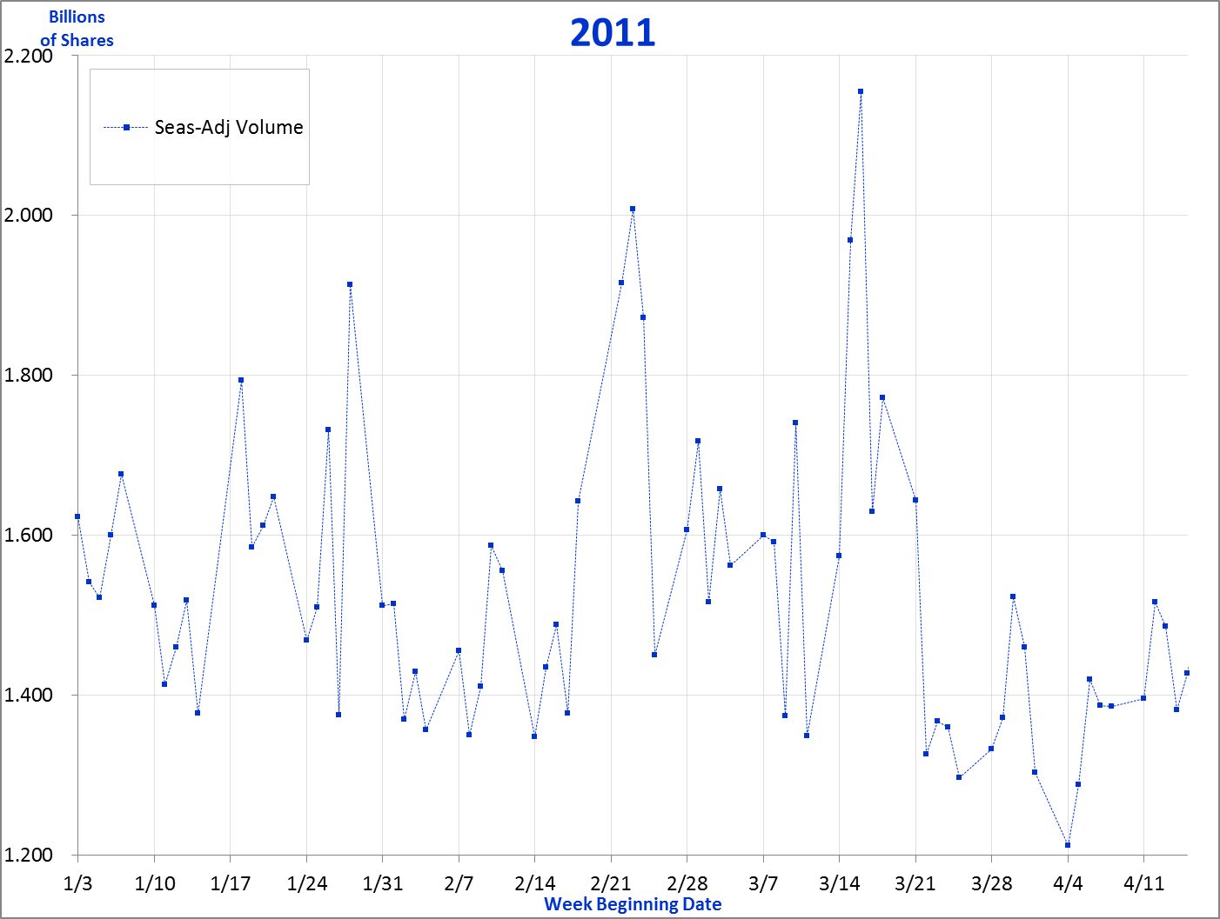
Estimating Trend Daily
Introduction
Model Set-Up
Estimating Trend
Low Factor Adjustments
Key Points
The chart completes the “picture” of the estimation of trend. The volatile daily seasonally-adjusted volumes are shown, in light blue.
DailyTrendModel: 2011
38
8 -
Notes:
We now turn to the chart, which as usual, is found to the right of the growth & event estimates. We’ll walk thru each of the lines displayed on this chart, starting with the daily seasonally-adjusted volumes. As you can see, they’re pretty volatile; they’d be even worse if we took out the seasonalizing. Because the line tends to be so erratic, it’s downplayed on this chart by displaying it thinly, in a fairly faint shade of blue.

Slide 39
Estimating Trend Daily
Introduction
Model Set-Up
Estimating Trend
Low Factor Adjustments
Key Points
Note that the X-axis is formatted to show the starting date for each week.
DailyTrendModel: 2011
39
8 -
Notes:
The x-axis of the chart is set to clarify the dates displayed for the daily data. This weekly setting is obtained by right-clicking on the x-axis, clicking on “Format Axis”, and then under Axis Options, setting “Major Unit” to “Fixed” (not “Auto”) and to a count of “7” and to “days” (as opposed to “Months” or “Years”). What should the “Minimum” figure be? The “Minimum”, which essentially determines the starting date for the chart, is set to 1/3/2011. Why “1/3”? Because that is the date of the Monday that is associated with the 1st data point in January. The date was picked up from what I’d earlier inserted in Row 42 of the “2011” tab. Note that if I wanted the chart to start with February, I would use the date “1/31” rather than “2/1” as the starting date. Why? Because I want it to be clear that the vertical gridlines on the chart are always associated with a Monday, the 1st day of the week. It gets very confusing if you simply use the 1st of a given month as the starting point and then have a chart’s vertical lines be associated with any and all of the 7 days of the week. It’s a bit of work making sure you start with a Monday, but it’s a lot more work trying to comprehend a confusing chart.
Finally, note the format of the x-axis does NOT include the year. I set it this way because I’ve inserted the year as a heading for the chart instead, so displaying it on the x-axis as well is superfluous. However, if I ever wanted the chart to display more than one year, then the years would probably need to be displayed. To set the date format, again right-click on the x-axis, click on “Format Axis”, then click on “Number”, and then choose “Date” as the Category, and select the desired type. I chose what Excel shows as “3/14”, the most minimal date display they have.

Slide 40
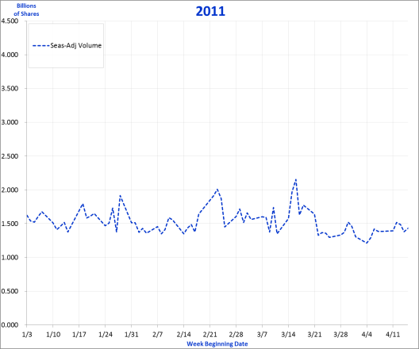
Estimating Trend Daily
Introduction
Model Set-Up
Estimating Trend
Low Factor Adjustments
Key Points
And note that the Y-axis will always need to be played with in order to have the chart better focus on where the action is with the data.
DailyTrendModel: 2011
40
8 -
Notes:
Meanwhile, the y-axis of the chart is also adjusted to have it better display the data in full. A small chart has been inset onto this page to give you an idea of what it would look like if you did NOT manipulate the y-axis. It would be extremely difficult to make out the data behavior without going thru the invaluable effort of adjusting the “Minimum” & “Maximum” values for the y-axis.

Slide 41
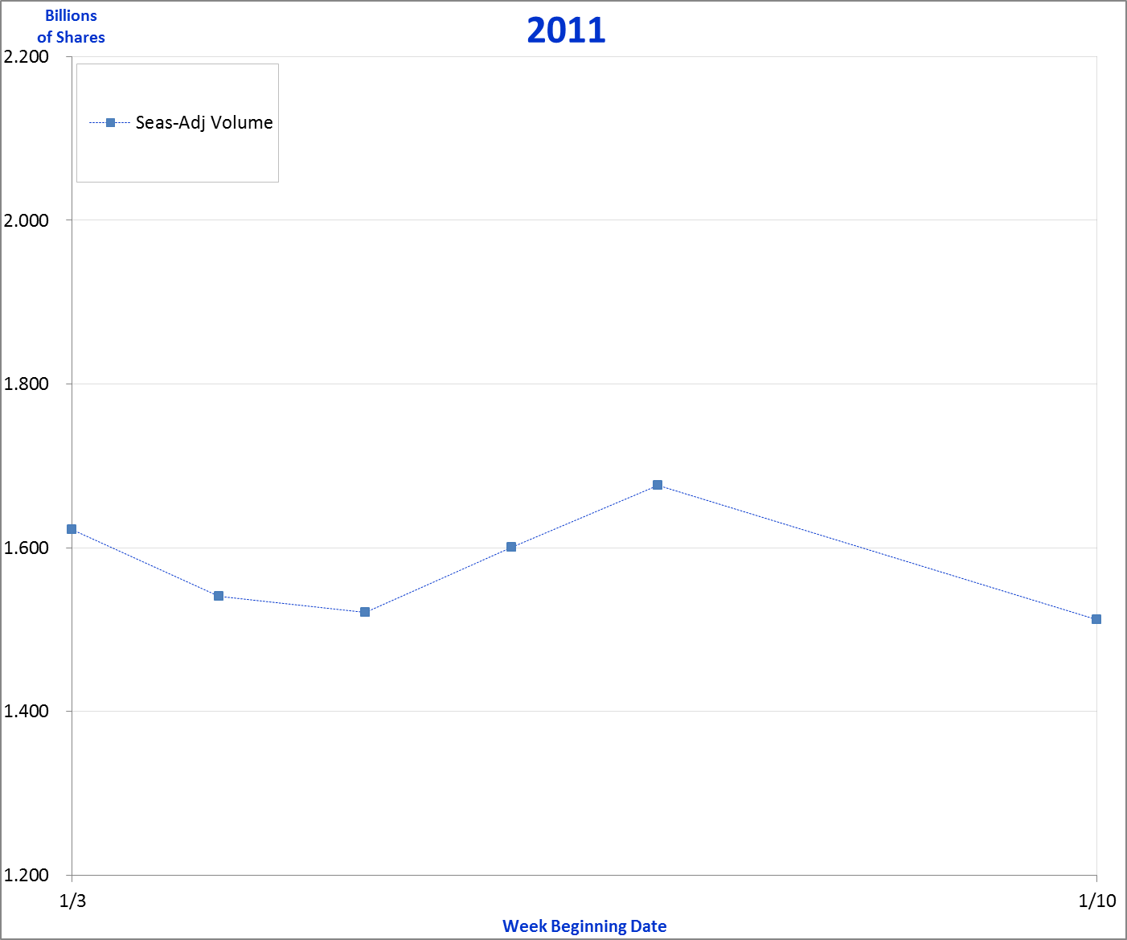
Estimating Trend Daily
Introduction
Model Set-Up
Estimating Trend
Low Factor Adjustments
Key Points
Due to the quirks of working with Excel, be aware that lines “skip” the weekend on the chart.
Fri
Mon
Thu
Tue
Wed
Mon
DailyTrendModel: 2011
41
8 -
Notes:
It may have been hard to notice on the previous page, so I’ve zeroed in on the 1st week of January. As you can see, the line plots the points for Monday thru Friday, and then the following Monday. But obviously, while the chart does not show any data points for the weekend, it does display a significant gap. I’m not aware of any method for eliminating this, but I’m not sure that’s necessarily a problem. While it’s a bit irritating to have the long line going from Friday to the subsequent Monday, it’s arguably appropriate since there are days there being “missed”.

Slide 42
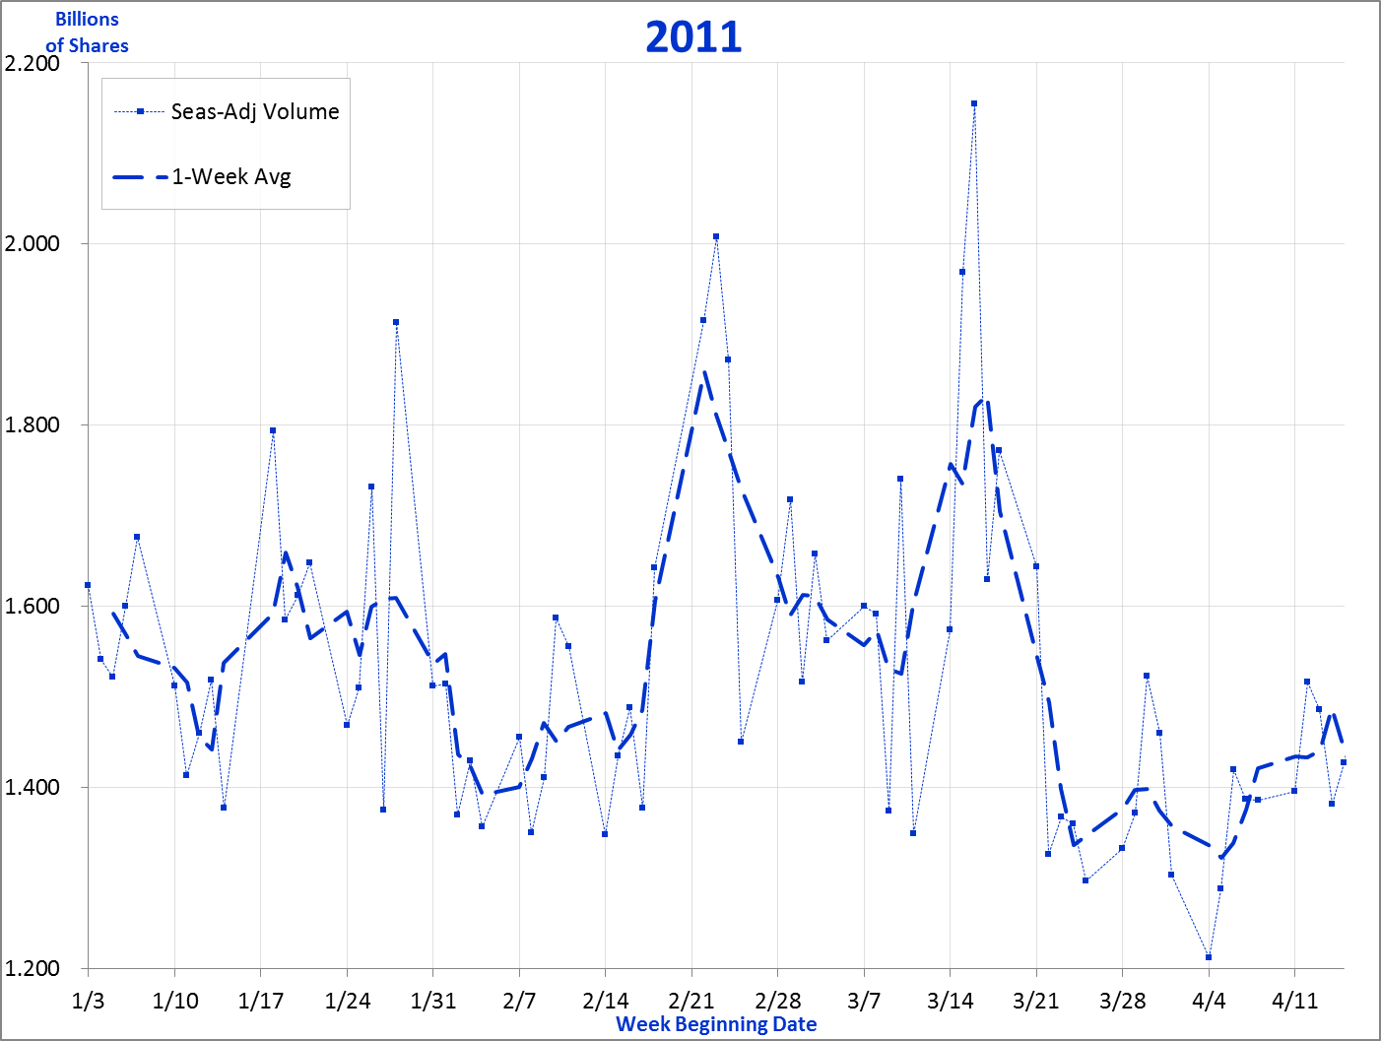
Estimating Trend Daily
Introduction
Model Set-Up
Estimating Trend
Low Factor Adjustments
Key Points
A 1-week moving average is displayed …
DailyTrendModel: 2011
42
8 -
Notes:
We next show the 1-week moving average, which comes from Col R of the “Calc” tab.

Slide 43
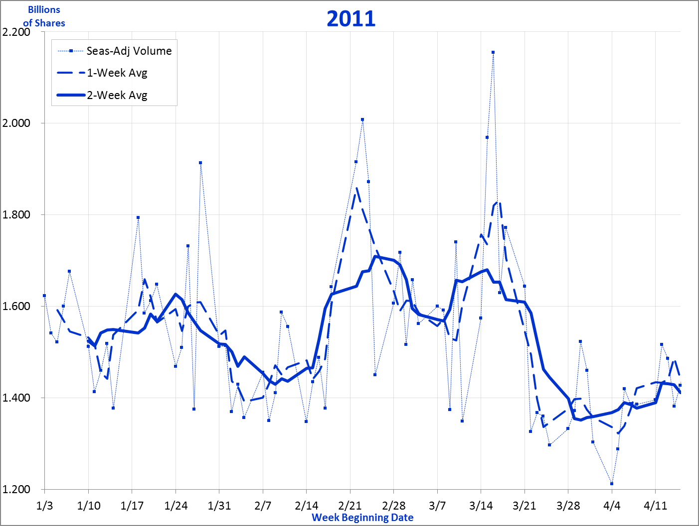
Estimating Trend Daily
Introduction
Model Set-Up
Estimating Trend
Low Factor Adjustments
Key Points
… as well as a 2-week average.
DailyTrendModel: 2011
43
8 -
Notes:
And then add the 2-week moving average. Each one is useful, but when both are there, it can be a bit confusing. My preference is to have just one moving average line. And between the two, I think the 2-week average line is better. Certainly that seems the case here, for the 2-week average is similar to, while less erratic than, the 1-week average. Both are calculated and displayed so that one can choose which is better. And of course, you could easily change the 1-week line to simply calculate a 3-day moving average or any other length you prefer to use that helps elucidate how the data is performing.

Slide 44
Estimating Trend Daily
Introduction
Model Set-Up
Estimating Trend
Low Factor Adjustments
Key Points
By hiding the column of an unwanted 1-week average, it will disappear from the chart, but can be easily re-displayed by simply unhiding that column.
DailyTrendModel: 2011
DailyTrendModel: 2011
44
8 -
Notes:
In order to eliminate one of the lines from the chart, I choose to simply hide the data on the “Calc” tab. The benefit of doing it this way is that if one later wants to see the other line, all that needs to be done is to unhide the column. But if you delete the line on the chart, you have to go back in and add it to the chart, which is a far more laborious procedure. Much simpler to just hide or unhide the column of the line you wish to hide or display. Here, the 1-week average line is removed from the chart by simply hiding its column, column R. Remember, because this model is on Manual Calc mode, when you go back to the chart, you’ll need to hit the F9 Calc button at the top of the keyboard in order to update the chart display to conceal the line.

Slide 45
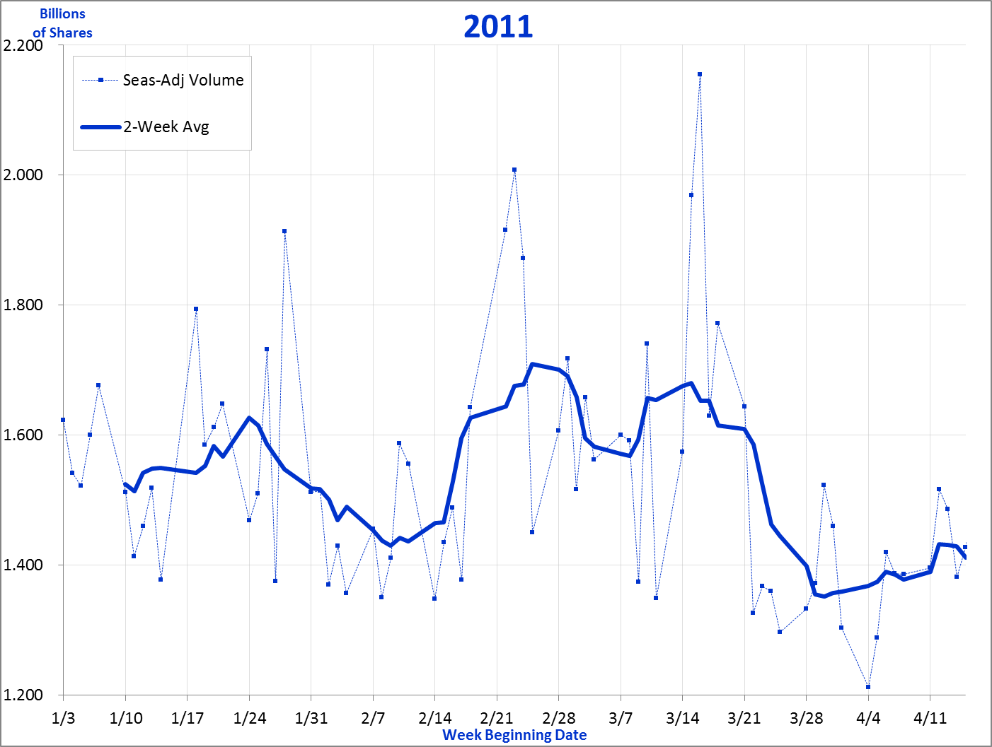
Estimating Trend Daily
Introduction
Model Set-Up
Estimating Trend
Low Factor Adjustments
Key Points
Hiding the 1-week average line makes for an easier read of how the daily data is trending over time.
DailyTrendModel: 2011
45
8 -
Notes:
Hiding the 1-week line appears to really help clarify the display, and make it easier to determine the estimated trend line.

Slide 46
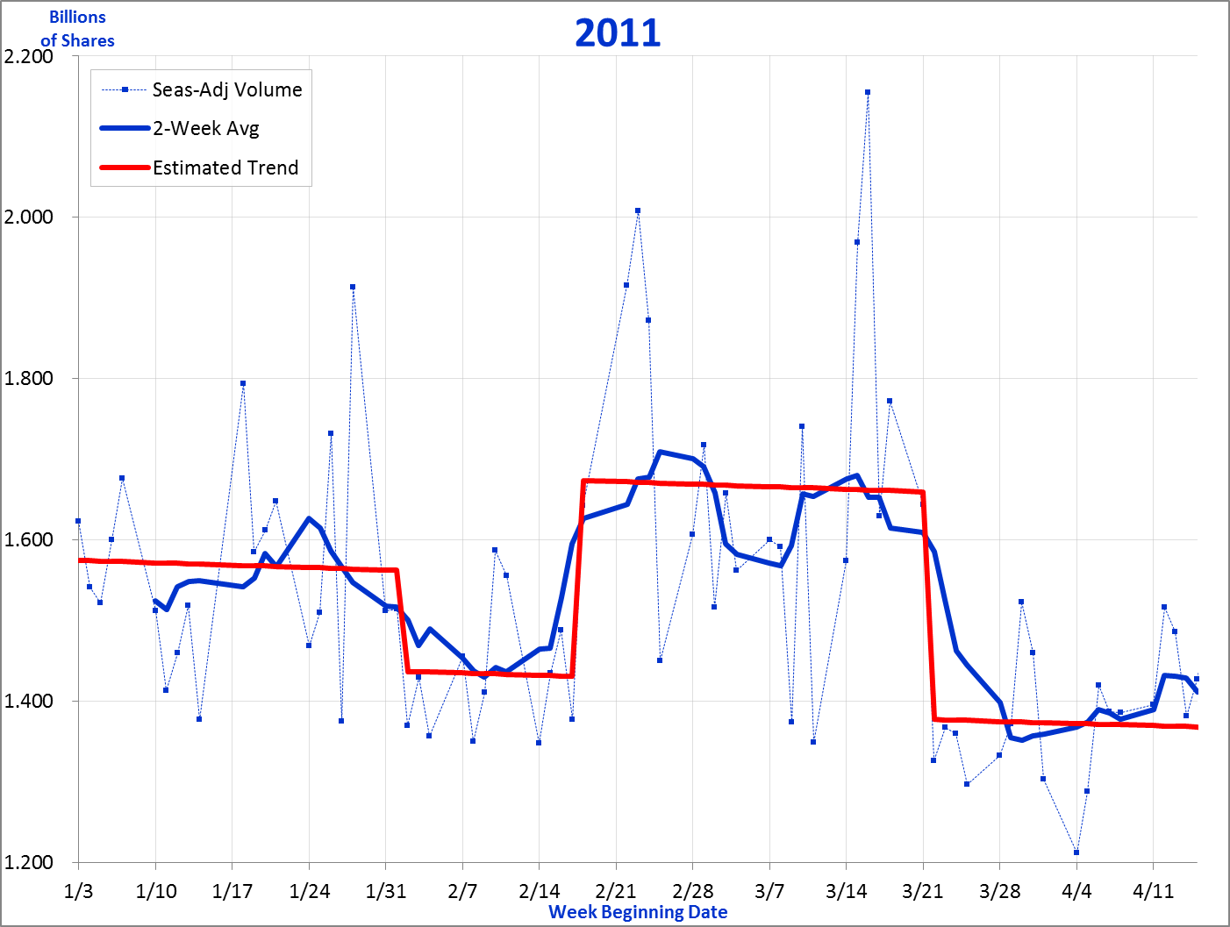
Estimating Trend Daily
Introduction
Model Set-Up
Estimating Trend
Low Factor Adjustments
Key Points
With the adjusted daily volumes & 2-week averages as guides, the chart is ready for determining the estimated trend line.
DailyTrendModel: 2011
46
8 -
Notes:
The estimated trend line completes the picture of the daily trend model.

Slide 47
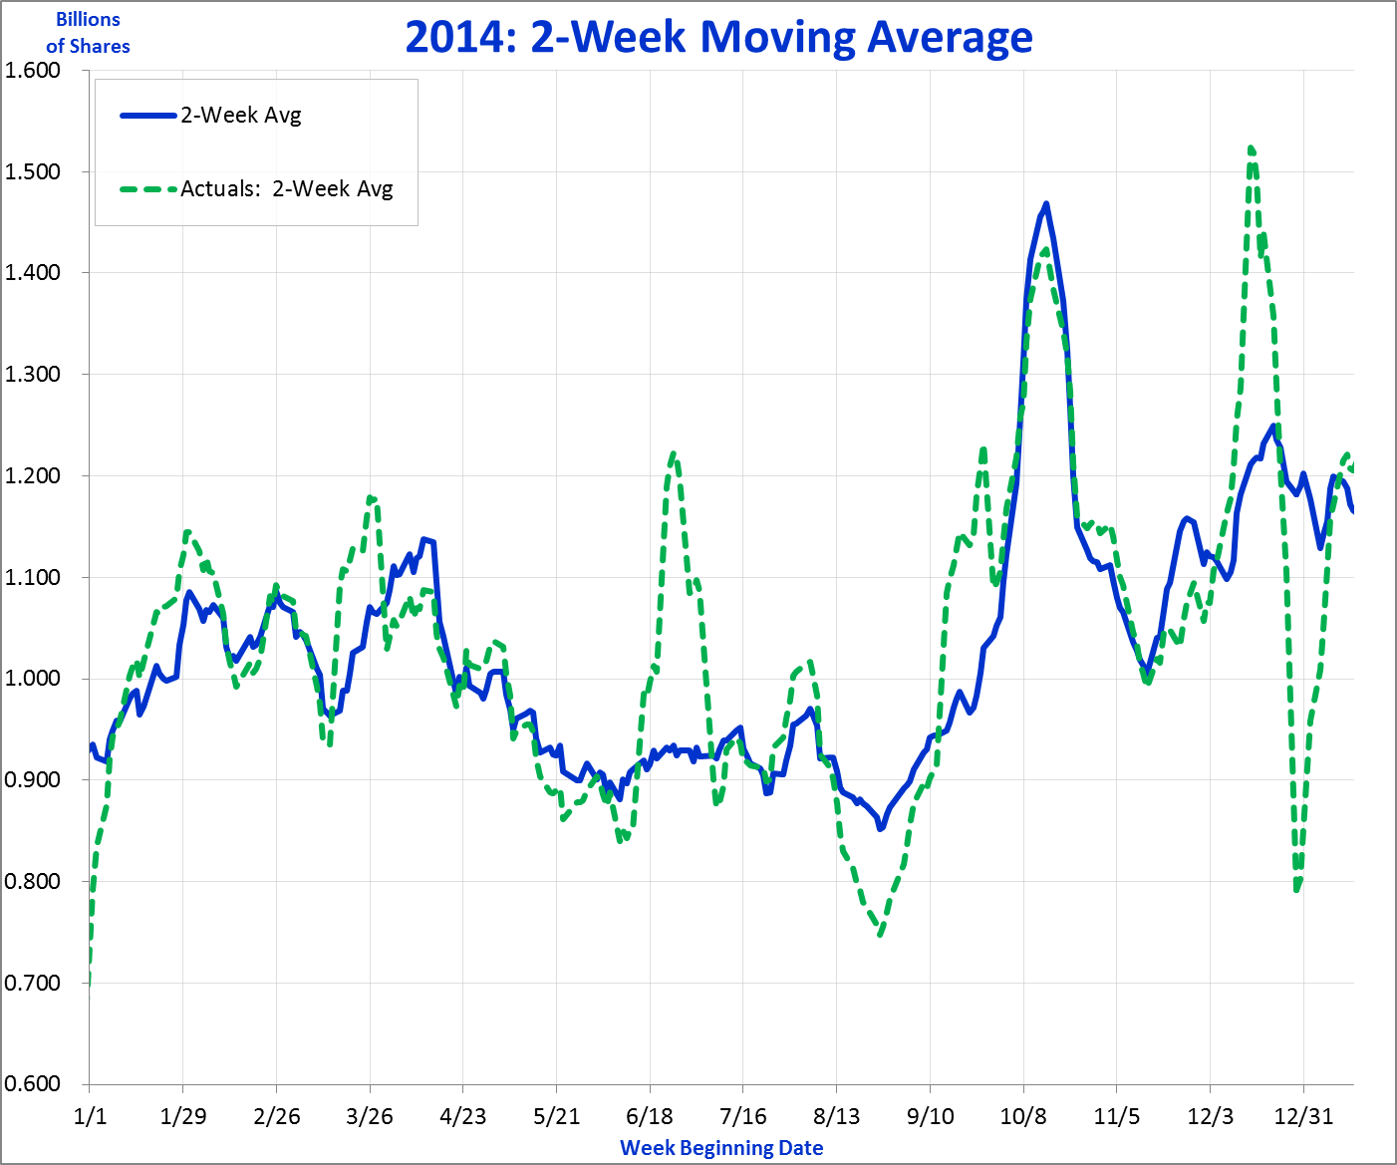
Estimating Trend Daily
Introduction
Model Set-Up
Estimating Trend
Low Factor Adjustments
Key Points
If you’re wondering whether all this seasonalizing is worth it, here’s what 2014 looks like using the unadjusted actuals.
Seasonally-Adjusted
Unadjusted Actuals
DailyTrendModel: 2011
47
8 -
Notes:
It’s easy to think that once you apply something like a 2-week moving average that, of course, the data will be much smoother and easier to read. So why bother with all the seasonalizing, the adjusting for day of the week, day of the month, holidays, and the month of the year. This chart hopefully demonstrates why it still is worthwhile. Yes, the seasonally-adjusted line still has volatility, but nothing like that of the 2-week moving average on the original unadjusted actuals. Yes, much of the spiking for the unadjusted line is due to the enormous influence of those quarterly 3rd Fridays. But notice how differently August behaves when it is not adjusted for its distinctive day of the month pattern; how volatile the data is surrounding the Christmas holiday; and how rarely, if ever, the data appears smoother than the seasonally-adjusted data. It’s a lot of effort to be sure, but it clearly makes quite a difference. Granted, I picked 2014 because the difference was so impressive, but every other year also witnessed a marked deterioration when the unadjusted line was brought out. And perhaps even more importantly, even if the unadjusted line had been smoother, it is not “truer” for it is not adjusting for predictable fluctuations. And by not adjusting for those predictable fluctuations you run the high risk of misinterpreting how the data is behaving over a given period of time.

Slide 48
Estimating Trend Daily
Introduction
Model Set-Up
Estimating Trend
Low Factor Adjustments
Key Points
There are a number of guidelines to keep in mind as you walk through estimating trend on the daily data.
Limit changes to 1-2 per month.
Sort out “growth” vs “event”.
Capture change on correct calendar day.
Monthly totals within 1-2% of actuals.
Annual total within 0.2% of actuals.
Estimating Trend
48
8 -
Notes:
As before, we will want to keep a few general guidelines in mind as we walk through the process of estimating the “Estimated Trend” line. These are guidelines, and on occasion will necessarily or unavoidably be broken. But they remain good goals to strive for along the way.
First, try to limit changes to 1 or 2 per month. Perhaps an event occurs that begins & ends within a calendar month, requiring a positive & negative event estimate – there’s two changes right there. Add another event, or change in growth and this guideline is broken. So yes, this will occasionally occur. But hopefully these are the exception, not the rule. Put another way, hopefully the total number of changes over a given year will add up to less than 20. Once you go beyond that, it really becomes increasingly difficult to LEARN from the data, to truly understand what’s going on. Of course, if you can identify virtually each and every one of those changes – not only know what’s causing it but be able to feel comfortable that the level of change makes sense given your understanding of the metric, then that’s fine. But if you can’t explain most of the changes, you have to wonder how useful the product will be, how much people will likely turn to it for understanding how you’re doing, and why.
The second point is perhaps the most important, and speaks to the heart of what this entire “book” is about. It’s the matter of distinguishing “growth” from “events”. When numbers increase or decrease over time, we quickly call it growth or decline, when so often it’s really a “lift” or a “drop”. Change over time usually occurs as a result of specific events that suddenly cause a given metric to jump up or down, and not due to some steady “growth”. To be sure, there may be an underlying growth that accounts for some of the change, but data rarely behaves smoothly over time, and the changes are usually explained as shifts that can be otherwise called “events”, rather than simply ascribing it to a change in the slope of the metric. The fundamental importance of this distinction will become apparent when we try to estimate the trend line, and to decide whether a change of course should be captured as an event that brings the metric up or down overnight, or “growth” that sees the metric change its slope dramatically. And you will hopefully come to agree, that far more often than not, change should be captured by the “event” (lever) rather than as “growth”.
Third, we want to be sure to capture a change on the correct calendar day. With the gyrations in the data, and the tendency to focus on the easier-to-read 2-week moving average, we nonetheless want to be sure changes are implemented on the appropriate day.
Fourth, as we proceed, we want to make sure the estimated line is close to the actuals. This is tracked by the Actuals vs Estimate comparison section. And here we will want to try to keep the difference between the two to less than 1% each month, and to accept perhaps up to a 2% difference as an exception. Now, your data may be far more volatile than the NYSE sales volumes, and even 2% differences will be elusive. If so, try to establish a fair maximum and stick to it. This will still help guide your estimations so that they still align fairly well with what the “true” trend of the data may be.
Finally, while 1-2% may be the goal for the differences on a monthly basis, try to have the difference for the year as a whole contained to perhaps less than 0.2%.

Slide 49
Estimating Trend Daily
Introduction
Model Set-Up
Estimating Trend
Low Factor Adjustments
Key Points
The Trend tab will be formatted in these pages to help maximize the size of the chart, while being able to clearly see the changes & entries made.
May thru Nov hidden
Event
Rows
Narrow
DailyTrendModel: 2011
49
8 -
Notes:
To begin, I want to point out the formatting changes I’ve made to the worksheet so you are better able to see changes and entries. I’ve hidden the columns for the growth & event entries from May thru November. Also, I’ve severely narrowed the rows in the “Events” section by setting the row height at “1” for every row except the rows where event entries are made (so you can anticipate entries on the 2nd, 18th, & 22nd days); the 1st & 31st will always be shown fully as they bookend the month.

Slide 50
Estimating Trend Daily
Introduction
Model Set-Up
Estimating Trend
Low Factor Adjustments
Key Points
We start by setting the approximate level of where the first examined year begins, set here at around 1.6 billion.
DailyTrendModel: 2011
50
8 -
Notes:
So to start out, we need to set the beginning level, which of course would correspond to the approximate level activity is at when the period begins. This is manually input in Cell N9 near the top of the page. I’ve used 1.6 billion as starter, very close to the approximate level it appears to average over the 1st week or so.

Slide 51
Estimating Trend Daily
Introduction
Model Set-Up
Estimating Trend
Low Factor Adjustments
Key Points
We then set the growth rate, initially using the growth rate established in the Monthly Trend model.
DailyTrendModel: 2011
51
8 -
Notes:
Next I need to insert a growth rate. I recommend initially using the growth rate established in the Monthly Trend model. Arguably, the growth rate used in that model should probably be what’s used in this model as much as possible. Certainly doesn’t have to be an identical rate, or applied over an identical time period, but generally speaking you will likely do well to try to come close to matching the growth rate used in the monthly trend model. This rate was based on the “higher perspective” offered by looking at monthly data.
We earlier input the Monthly Trend Estimates in Row 50, as reference. We can see from the highlighted row that a growth rate of -10% was used for the entire year. So that certainly seems like a good rate to set out with.

Slide 52
Estimating Trend Daily
Introduction
Model Set-Up
Estimating Trend
Low Factor Adjustments
Key Points
One of the great temptations, usually best avoided, is to chase apparent steady changes in growth rates, such as the one highlighted here.
DailyTrendModel: 2011
52
8 -
Notes:
I mentioned earlier that generally speaking there will be few changes in growth rate applied to the estimation line, and that usually these should correspond with changes inserted in the Monthly Trend model. Looking at the behavior of the 2-week average line in late January to early February, it appears to show a steady decline occurring. However, the reason for this decline is precisely because we are looking at a moving 2-week average. When a metric suddenly jumps or drops, the moving average will take much longer to accomplish the same level of rise or fall. So the steady drop here really is the result of a fairly sharp drop occurring right at the end of January, & at the very start of February.

Slide 53
Estimating Trend Daily
Introduction
Model Set-Up
Estimating Trend
Low Factor Adjustments
Key Points
It can require some breathtaking growth rate values to accurately capture a significant change in growth. An annual rate of -250% works here.
DailyTrendModel: 2011
53
8 -
Notes:
Just for the sake of argument, let’s try to create a trend line that replicates the apparent decline in sales. As you can see, an annual rate of -250%, applied on January 26th, seems to match almost perfectly the general slope of the 2-week average line. How can the rate be less than -100%? Because the rate is an annual rate, so each day 1/365th of that rate is applied. So actually each day is seeing a drop of something slightly under 0.7%. The growth rate then is returned to the former rate of -10% the following February 10th, just as the 2-week average line stops declining. Aside from the obvious fact that the 2-week average takes two weeks to capture a sudden shift in the metric, one also must question the usefulness of an annual rate like “-250%”. Imagine the kind of alarm that would stir in the executive suite. And how would you answer the question, “what does that rate mean”?

Slide 54
Estimating Trend Daily
Introduction
Model Set-Up
Estimating Trend
Low Factor Adjustments
Key Points
While it may be clear that inserting an “event” is the appropriate approach, you then have to consider the target level to obtain.
Which one?
DailyTrendModel: 2011
54
8 -
Notes:
All right, so hopefully you can now agree that usually you will want to apply an “Event” rather than a change in the growth rate to capture how performance is trending over time, day-by-day. The next question then becomes, to what level do you raise or drop your trendline, when an event occurs? This question was relatively more straight-forward when we were looking at monthly data for there were so few data points to consider, and we were always trying to avoid applying too many shifts and changes to trend. But with daily data we find ourselves going back and forth between the daily data itself, and the moving average on that data. A perfect example of this dilemma concerns where to shift the trendline to at the start of February. If we look at the daily data, we see that most of the data points coalesce around the solid pink line, just below the 1.4 billion sales level. On the other hand, the 2-week average never dips below the line described by the dotted line on this chart. Of the two, which is the more appropriate or correct line? I would suggest the dotted line is the more appropriate, for it better aligns with the general trend in the data. While much of the daily data is lower over those 1st two weeks or so of the month, the 2-week average line indicates that the average never drops below where the dotted line has been inserted. Indeed, we are talking about a period of approximately two weeks, and the midpoint of that period is right around that minimum level; accordingly, the dotted line definitely seems an appropriate target level.
Now this is just one example, and every set of data will behave differently. The point I wish to make here is that setting the trendline involves looking at both daily behavior and the 2-week (or 1-week moving average), that generally the daily data is most valuable for informing when to apply an event, while the moving average is key for determining target levels.

Slide 55
Estimating Trend Daily
Introduction
Model Set-Up
Estimating Trend
Low Factor Adjustments
Key Points
The timing of events corresponds with the day best reflecting when a shift occurs, while the level of change aligns with the 2-week moving average.
55
8 -
Notes:
This charts illustrates the point we were just making, that the timing of the event here is the 2nd of February, for that is when sales volumes realize a markedly lower level. Yes, one could time one drop for Jan 31st, with a second drop on Feb 2; but then you run the risk of having too many data shifts to deal with, and more importantly, too many to explain. An event of -9% (Cell D112) brings us to the approximate level we desire; playing with -8% and -10% left us at too high and too low a level, respectively. Before leaving this change, notice where the trend line now continues. Obviously there is a big shift up we’ll need to apply around Feb 18th, but it’s interesting to observe how the trend line aligns with the daily data from March 22nd on – perhaps a bit high, but not by much.

Slide 56
Estimating Trend Daily
Introduction
Model Set-Up
Estimating Trend
Low Factor Adjustments
Key Points
As there are no changes occurring in January, we should be able to have an actual vs estimate difference for that month that is very close to 0.
DailyTrendModel: 2011
56
8 -
Notes:
While the drop we’ve inserted for the start of February looks about right, we need to go back and take another look at January. By having no event or growth rate change entered for January, we’re essentially committing ourselves to a trend line that should be at a level that almost exactly matches the actuals in that month. But we can see that the estimate is almost 2% higher than actuals. We want to reduce this gap, and we do so by reducing our starting point in Cell N9. However, when we drop the starting level, we’ll also then need to make sure to also reduce the -9% drop for Feb 2, in order to ensure the trend line continues to hover around the level it’s at here during February.

Slide 57
Estimating Trend Daily
Introduction
Model Set-Up
Estimating Trend
Low Factor Adjustments
Key Points
“Playing” with the starting level gets us to a much reduced gap for January, while tweaking the February event obtains the right level to start the month.
DailyTrendModel: 2011
57
8 -
Notes:
To get to the right starting level in January, I simply “played” with the amount in Cell N9. I even changed the unit display so I could get the difference down to zero at the 1/100th of a billion level (which meant the month totals would differ by less than 5 million). This will probably be the only time I try to obtain this level of precision. Normally it is just not possible or appropriate to try to get it so exact. But here we are dealing with the starting level, and it seems just fine to at least try to set out at the right level, down to the nearest 1 million. And this was accomplished by dropping the starting level initially down to 1.58 billion, and then ultimately down to 1.576 billion. That gets us to an almost exactly 0 difference for January. I then needed to bump the event amount up to -8%, from -9%.

Slide 58
Estimating Trend Daily
Introduction
Model Set-Up
Estimating Trend
Low Factor Adjustments
Key Points
Much of the trend estimation process consists of working with the timing and values for events, making sure each month’s actual vs estimate gap is minimal.
DailyTrendModel: 2011
58
8 -
Notes:
And so it goes. The trend estimation process is a constant interplay between setting events, and the occasional growth rate changes, such that the difference between the actuals vs estimates is minimized. Again, we’d like to try to contain each month’s difference to 1-2% at most, and to keep an eye that the differences aren’t always positive or always negative, that they swing back & forth so that the year total difference should be very close to zero.
In this example with the NYSE sales, I looked ahead and could see that I wanted an event on March 21st that would drop the level to around 1.4 billion, taking the trend line about to where it is on the chart here. I also needed to enter a positive event on Feb 18, corresponding with the date the jump in sales occurs. I found a “+17%” event for Feb 18 and a “-16%” event for March 21st appeared to give me a line that fit very well with the running 2-week average, the timing of the daily jumps, and which gave me differences for February and March of around 1% and 0% respectively. That seemed pretty good, and with that the 1st quarter of 2011 was complete.

Slide 59
Estimating Trend Daily
Introduction
Model Set-Up
Estimating Trend
Low Factor Adjustments
Key Points
Once a given period is done, reset both chart axes to reveal the next period. Show the prior period’s last month - for reference, & potential modification.
DailyTrendModel: 2011
59
8 -
Notes:
We now shift to the next few months. The chart needs to be reset. You will likely find it helps to still show the last month of the prior period. So we had earlier worked on Jan thru March. I’ve set the next chart to still show March, as well as April & May, & part of June. As we’ll soon see, maintaining that visibility is helpful as you may find it necessary to go back and modify the prior period.
Of course, you’ll also probably need to reset the y-axis range; here the minimum was dropped from 1.2 billion to 1.1, while the maximum was dropped from 2.2 to 1.8 billion.

Slide 60
Estimating Trend Daily
Introduction
Model Set-Up
Estimating Trend
Low Factor Adjustments
Key Points
Sometimes the actual vs estimate gap is caused because of an estimate used in a prior month.
DailyTrendModel: 2011
60
8 -
Notes:
As has hopefully been made clear by now, this approach to estimating trend requires a constant back-and-forth review and modification of the estimates inserted for growth rate & events. Some choose to have software do this task for them – fine, but do you fully understand what that software is doing? And does the output of that software make sense, and how useable is it? With this approach, you’re essentially always asking yourself: what is the data doing, why does it change as it does, and do those changes & explanations make sense? If you can answer those questions, you’ve built a solid foundation for answering the question, “how are you doing?”.
Looking at the next NYSE period, we see an example of one of the situations you are likely to encounter: the gap for a given month is created by estimates made for a prior period, even though you may have liked the estimate you’d previously made. So here we had used “-16%” as the event estimate for March 22. But we can see that this estimate leads to a sizeable gap of 3% for April (Cell F47). We’re going to want to increase the March 22 drop (in Cell E132).

Slide 61
Estimating Trend Daily
Introduction
Model Set-Up
Estimating Trend
Low Factor Adjustments
Key Points
Modifying a prior estimate can help reduce the gap for a given month, though it can then lead to larger gaps in subsequent months.
DailyTrendModel: 2011
61
8 -
Notes:
As noted, we want to increase the amount of the drop for March 22, changed here from “-16%” to “-17%” (Cell E132). I tried “-18%”, and while that made for a smaller gap in April (of just -0.1), it also led to the estimate being low by 1.0, or “-3%”, in May. Consequently, I’ve compromised here by using “-17%”. While a +2% actual vs estimate gap remains for April (Cell F47), it is offset by a -2% gap for May (Cell G47).
Of course, I could reduce the gaps in both months by making additional changes. But I chose not to as the 2-week moving average appears relatively smooth over this period. While there is some slight shifting up or down every week or two, none of it seems very significant, so I think it warrants having the one simple line track across the whole two month period. You may disagree, in which case you may make additional modifications, or perhaps slightly alter the settings I’ve employed. There really is no one right answer. However, if you knew what was going on, if you had the inside track on the behavior of the time, then you would be in a much better position to determine if and when more modifications were appropriate – simply because you knew it made sense and you knew their application better fit the behavior of the data.

Slide 62
Estimating Trend Daily
Introduction
Model Set-Up
Estimating Trend
Low Factor Adjustments
Key Points
The estimation process continues, running 3-4 months at a time.
DailyTrendModel: 2011
62
8 -
Notes:
The estimation process continues into the next period. Ordinarily, I would have had the next period – on the chart – run thru Aug 15, or even Sep 15. But I cut off the end at 8/1 here because there is a huge increase coming, and the chart scale will have to widen substantially to accommodate it. By confining the period to May thru July, I’m able to maintain a better look at the daily cycling of the data on the chart. And here I’ve chosen to insert a 9% bump at the end of May (Cell G141), an 11% drop on June 20 (Cell H130), & a 20% bump on July 27 (Cell I 137). These changes appear to fit the data well. Also, there are small differences in June & July. As for the April & May gaps, while they are a bit larger than I’d like, they nicely offset one another, so that combining the two months results in almost zero difference. Now on to the August sales surge…

Slide 63
Estimating Trend Daily
Introduction
Model Set-Up
Estimating Trend
Low Factor Adjustments
Key Points
When a prolonged spike occurs, the lift should equate with the total net increase over the period.
DailyTrendModel: 2011
63
8 -
Notes:
Inevitably, there will be occasions where a metric experiences a dramatic rise (or fall) for a prolonged period of time. When these occur, if you can, and its appropriate, you want to insert a single lift (or drop) that captures the net change for the entire period. The early August sales surge shown here provides a perfect example. From Aug 4 thru Aug 12, sales were over 2 billion shares each day, reaching a peak of almost 4 billion on Aug 8. Rather than trying to capture the increases or decreases each day, or every other day, you want to set the lift for the period such that the estimated trend values sum to a total that is very close to the actuals. That is what has been accomplished here by inserting a lift of 105% on Aug 4 (cell J114); a drop of 37% was entered on Aug 12 (Cell J122), designed to capture the new level of sales that occurs over much of the rest of August. How did I come up with 105%?

Slide 64
Estimating Trend Daily
Introduction
Model Set-Up
Estimating Trend
Low Factor Adjustments
Key Points
To verify a prolonged lift is set correctly, make sure that the total Estimate vs Actuals Difference is close to 0.
Total Diff
= (0.021)
DailyTrendModel: Calc
64
8 -
Notes:
The way to make sure your estimate of a prolonged lift has been set correctly is to toggle back to the “Calc” tab and verify that the total Estimate vs Actual Difference is close to 0. The figure here shows the detail from the “Calc” tab for this period. You can see the event estimates in Col U, the 105% lift on the 4th (Cell U226) & the 37% drop on the 12th (Cell U234). And you can see the estimate vs actual differences highlighted in Col X. The goal here is to have the sum of these cells be close to 0. You can see that the estimate for the 4th is high by over 700 million shares, and that it is low by over 700 million shares on the 8th, but the key is that the total difference for these seven days combined is just 21 million. Not bad given that the total share sales for the period was over 20 billion. Getting this difference close to 0, while setting the drop at the end of the period so that it matches the approximate level sales are at going forward, is precisely what we want to achieve.

Slide 65
Estimating Trend Daily
Introduction
Model Set-Up
Estimating Trend
Low Factor Adjustments
Key Points
If a 1-day spike is large enough (a change of perhaps 50% or more), it may be appropriate to insert an “event reversal”.
DailyTrendModel: 2011
65
8 -
Notes:
The rest of the summer period is estimated above. A lift - of 21% (Cell L113) - was inserted for the Oct 3-11 period, again verifying on the “Calc” tab that the total difference for those days was minimal. Drops were added in late Aug & at the start of September. As you can see highlighted, a 1-day spike was inserted for Sep 22. You’ll also notice that for virtually the entire month of September, the estimated trend line is slightly below the 2-week moving average. Should it be raised? No, for the Estimate vs Actual difference for September is close to 0, & there’s a slight positive difference at that. I certainly could have used a lower decline on September 1: using “-10%” instead of “-12%”, the difference is again a positive 0.1 billion; but that difference is obtained by leaving out the Sep 22 spike. That’s a judgement call. What would the latter half of Sep look like if there hadn’t been that 1-day spike? Well, the 2-week moving average line would have likely ended up almost exactly where I have traced the estimated trend line here. I’m content to run it like I have here, for I want to capture the substantial 1-day spike in my estimated trend, which I’ve done with the 50% lift estimate (Cell K130). The Event Reversal Formula (see Chapter 6) was applied to derive the -33% drop the following day (Cell K131).

Slide 66
Estimating Trend Daily
Introduction
Model Set-Up
Estimating Trend
Low Factor Adjustments
Key Points
A series of step functions captures the decline over the rest of the year.
DailyTrendModel: 2011
66
8 -
Notes:
As you can see, I’ve finished off the year by inserting a few more step functions. These are inserted at the approximate dates that drops occurred, and are of a magnitude that the monthly estimate vs actual differences are close to 0.

Slide 67
Estimating Trend Daily
Introduction
Model Set-Up
Estimating Trend
Low Factor Adjustments
Key Points
One might argue there appears to be a steady decline occurring through much of the last few months – it’s usually better to ignore these.
DailyTrendModel: 2011
67
8 -
Notes:
If you look again at the last few months of 2011, it is quite striking how there appears to be a fairly steady downward trend over this period. The heavy dashed pink line attempts to approximate this decline. What does it look like if we have the model capture this alternative perspective on sales behavior over the last quarter?

Slide 68
Estimating Trend Daily
Introduction
Model Set-Up
Estimating Trend
Low Factor Adjustments
Key Points
Even over extended periods of time, severe annual growth rates are required to capture significant declines.
DailyTrendModel: 2011
68
8 -
Notes:
The figure here displays what it takes to have the model trace the kind of decline suggested by the slope of the 2-week moving average over the last few months of 2011. We saw this earlier, when we looked at the decline over the late January-early February period. Again we see that it requires extraordinary values to capture the rate of decline. Here an annual growth rate of “-170%”, applied on Oct 19, thru Dec 29, seems to fit the data.
There are three major problems with this alternative vision. First, there is the difficulty of getting your head around a “growth rate” of “-170%”. Of course, when applied on a daily basis, this actually equates to just under ½ of 1%; (170% divided by 365 days in the year). But how meaningful is such a rate? It seems unlikely that senior management would well understand the meaning of this, and much more likely that it would either prompt enormous alarm, or a concern by them that perhaps they need to look elsewhere than you for an understanding of how their business is faring.
Secondly, you have to think again about the distinction between the words “growth” & “event”. “Growth” implies a steady state, that one’s business is headed on a particular trajectory. And because “growth” is perceived as occurring over time, as opposed to at just one or two specific moments in time, one would understandably conclude that the situation is continually getting worse and worse each day. Meanwhile, when a drop is assigned to “events”, the business decline is perceived as being due to a one or more major negative occurrences. There’s a very different mindset about what is going on, depending on whether you describe a decline (or big rise for that matter) as being driven by “growth” or “events”.
Finally, the severe downward slope here really does not describe how the data is behaving. If you look closely at the daily line, you can see that it really does tend to coalesce around 1.5 billion during much of October, around 1.35-1.40 billion shares during November, around 1.25 billion shares in early December, and to settle out at around 1.15 billion shares at yearend. Applying a series of “events” better fits the data behavior, and certainly provides a much better understanding of how the data behaves over the last few months of 2011.

Slide 69
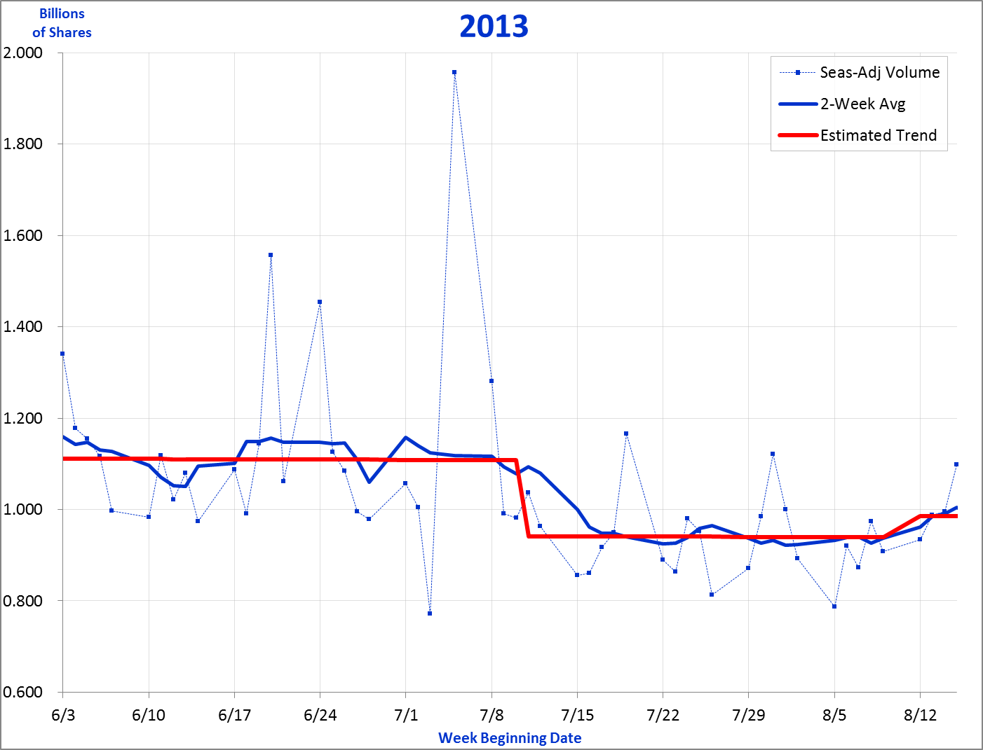
Estimating Trend Daily
Introduction
Model Set-Up
Estimating Trend
Low Factor Adjustments
Key Points
Sometimes spikes can occur in and around holidays. These spikes can be magnified by their holiday factors.
7/5
DailyTrendModel: 2011
69
Low Factor Adjustments
8 -
Notes:
I want to now address an issue that can sometimes arise with the daily data, an issue that is driven because sometimes the daily combined factors can be very low. Here is an example of this problem. In 2013, the seasonally-adjusted sales for July 5, the Friday following the July 4 holiday, was almost 2 billion. Such a huge number suggests that the actual sales that day were enormous. But that was not the case.

Slide 70
Estimating Trend Daily
Introduction
Model Set-Up
Estimating Trend
Low Factor Adjustments
Key Points
Sometimes very high seasonally-adjusted daily values can be driven by very low Combined Factors.
DailyTrendModel: Calc
70
8 -
Notes:
The driver of this issue can be better recognized by looking at the calculations behind it. We can see from this detail of the 1st weeks of July 2013, that there is a very low Holiday Factor for the Friday following the July 4th holiday, (a holiday factor of 0.41, per Cell G927). This is not surprising, as one can well imagine many taking off that day to enjoy a 4-day weekend. This low holiday factor leads to a similarly low Combined Factor of 0.43 (Cell O927). Actual sales that day totaled 850 million (Cell E927). We can see from the other days surrounding that, by itself, the volume was a bit below the other days (by around 10-20%). But when each day’s Actual value is divided by its Combined Factor, suddenly the 5th emerges as a huge spike, with its seasonally-adjusted volume of 1.957 billion (Cell Q927) coming in at almost double all the other days.
How shall we address this? With what I call a “Low Factor Adjustment”.

Slide 71
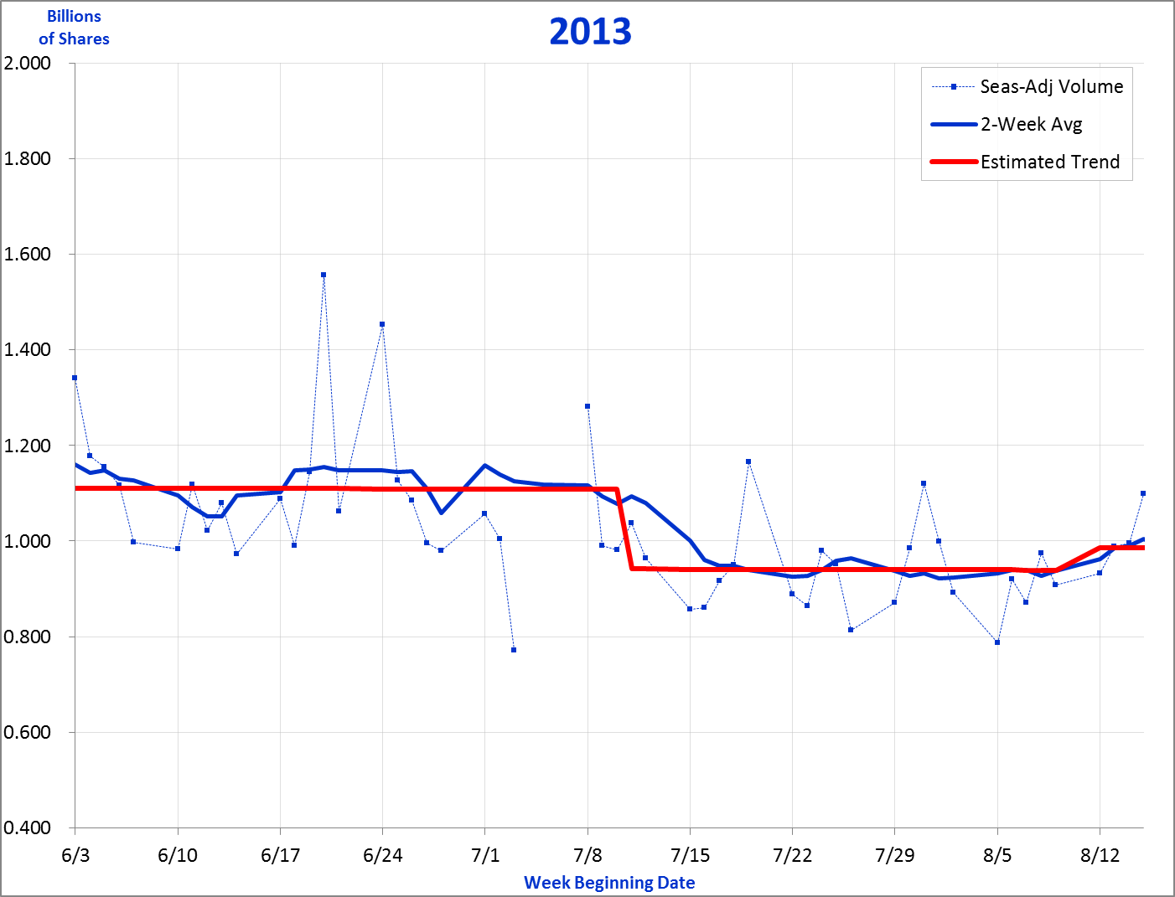
Estimating Trend Daily
Introduction
Model Set-Up
Estimating Trend
Low Factor Adjustments
Key Points
Developing a “Low Factor Adjustment” starts with determining what actual sales would “normally” be.
Trend: 1.108 B
“Normal Actual”: 0.481 B
DailyTrendModel: 2011
71
8 -
Notes:
The development of a “Low Factor Adjustment” is going to entail determining the gap between what sales normally would have been, and their actual value, then adding that gap to the trend. To see what that looks like, we start with determining what sales would normally have been on the day with the low Combined Factor. We have determined the Estimated Trend amount on July 5th is a little over 1.1 billion shares. July 5th has a combined factor of 0.43, implying that the “expected value” on the 5th would be 43% of the estimated trend, or the 0.481 billion shares marked near the bottom of the figure.

Slide 72
Estimating Trend Daily
Introduction
Model Set-Up
Estimating Trend
Low Factor Adjustments
Key Points
Next, we measure the gap between the normal sales and the actual sales that occurred.
Actual: 0.850 B
Gap: 0.369 B
“Normal Actual”: 0.481 B
DailyTrendModel: 2011
72
8 -
Notes:
Next we mark what the Actual sales were on July 5th, and measure the gap between the “Normal Actual” amount and the “Actual” amount. Here we see that gap was about 0.369 billion shares.

Slide 73
Estimating Trend Daily
Introduction
Model Set-Up
Estimating Trend
Low Factor Adjustments
Key Points
A proposed seasonally-adjusted sales is the sum of the Trend amount plus the Gap.
Proposed Adjusted Sales
= Trend + Gap = 1.477 B
Gap: 0.369 B
Trend: 1.108 B
Gap: 0.369 B
DailyTrendModel: 2011
73
8 -
Notes:
Then we add that Gap amount to the Trend amount. This gives us a Proposed Seasonally-Adjusted Sales for July 5th of 1.477 billion shares We’ve asked what sales would have been if the day had behaved “normally”. We then determined the difference between the actual sales and that normal amount, and then added (or subtracted) that difference onto the Trend.

Slide 74
Estimating Trend Daily
Introduction
Model Set-Up
Estimating Trend
Low Factor Adjustments
Key Points
The “Low Factor Adjustment” is the amount required to get from our original seasonally-adjusted sales to the Proposed Adjusted Sales.
Original Adjusted
Sales: 1.957 B
Low Factor Adjustment: (0.480 B)
Proposed Adjusted Sales: 1.477 B
DailyTrendModel: 2011
74
8 -
Notes:
Finally, we can determine the “Low Factor Adjustment”. It is going to be the amount by which we need to change the Original Seasonally-adjusted Sales in order to get to the Proposed Adjusted Sales. In our running example, originally the seasonally-adjusted sales was calculated as a whopping 1.957 billion shares. When we reduce this by a “Low Factor Adjustment” of 0.480 billion, we arrive at our Proposed Adjusted Sales of 1.477 billion.

Slide 75
Estimating Trend Daily
Introduction
Model Set-Up
Estimating Trend
Low Factor Adjustments
Key Points
The formula in the “Calc” tab calculates this “Low Factor Adjustment”.
DailyTrendModel: Calc
75
8 -
Notes:
Now that we’ve seen on the chart what this adjustment looks like, we return to the “Calc” tab to see what it looks like there. We can see that the formula in Col P has arrived at the desired Low Factor Adjustment of a negative 0.480 billion (Cell P927). We can also see, in the adjacent Cell Q927, that the new seasonally-adjusted volume is now the desired 1.477 billion shares. I refer you to the worksheet on this website to see the formula itself.

Slide 76
Estimating Trend Daily
Introduction
Model Set-Up
Estimating Trend
Low Factor Adjustments
Key Points
Note that the Low Adjustment Factor formula uses two key variables: a “Maximum Low Factor” and an “Adjustment Level”.
DailyTrendModel: Calc
76
8 -
Notes:
The calculation of the “Low Factor Adjustment” relies on two key variables that are placed at the top of the column: a Maximum Low Factor and an Adjustment Level.

Slide 77
Estimating Trend Daily
Introduction
Model Set-Up
Estimating Trend
Low Factor Adjustments
Key Points
The “Maximum Low Factor” determines when a “Low Factor Adjustment” is to be applied.
DailyTrendModel: Calc
77
8 -
Notes:
The “Maximum Low Factor” determines when a “Low Factor Adjustment” is going to be calculated. The point of the Low Factor Adjustment is to ensure that we avoid unusually high (or low) adjusted values being calculated, simply because the math results in a magnification of the amount. When the Combined Factor is 0.5, adjusted sales will double the actuals; if the Combined Factor is 0.1, adjusted sales will multiply the actuals by 10. But if the Combined Factor is 0.9, say, then adjusted sales will be about 11% higher than the actuals. We don’t want to be adjusting every calculation, we just want to focus on those where the adjustment is large. I’ve applied here a Maximum Low Factor of 0.5, meaning that anytime the Combined Factor is above 0.5, no additional adjustment will be made, but when the Combined Factor falls below the 0.5 maximum, then a Low Factor Adjustment will be inserted. That’s why you can see here that the only day that was adjusted is July 5th. Note that in the Excel worksheet, I’ve applied conditional formatting to the Combined Factors in Column O so that the cell will be highlighted whenever the Combined Factor falls below the Maximum Low Factor inserted in Cell P1.
Now why a maximum of 0.5? Well, this value is certainly somewhat arbitrary on my part. I wanted to make sure no day sees an overly large adjustment being made due to a low Combined Factor, and I felt a factor that doubles the actual value or more, is sufficiently impactful enough to merit some kind of adjustment. By all means, you should play with this and see whether you think a lower, or higher, maximum feels appropriate to you.

Slide 78
Estimating Trend Daily
Introduction
Model Set-Up
Estimating Trend
Low Factor Adjustments
Key Points
The “Adjustment Level” indicates the percentage of the Low Factor Adjustment that is to be applied.
DailyTrendModel: Calc
78
8 -
Notes:
The “Adjustment Level” in Cell P2 indicates the percentage of the “Low Factor Adjustment” that is to be applied. The input value here of “100%” implies we will take the full adjustment. A smaller (or larger) amount would imply the adjustment would be accordingly reduced (or enlarged).

Slide 79
Estimating Trend Daily
Introduction
Model Set-Up
Estimating Trend
Low Factor Adjustments
Key Points
How much the final seasonally-adjusted sales is effected depends on the “Adjustment Level” setting.
Adjustment Level = 0%
Adjustment Level = 50%
Adjustment Level = 100%
DailyTrendModel: 2011
79
8 -
Notes:
The impact of the “Adjustment Level” setting inserted in Cell P2 of the “Calc” tab can be observed in this figure. If the Adjustment Level is set at 0%, we return to the original high level of nearly 2 billion shares. Set at 50% or 100%, we end up at the lower amounts shown on the chart. This is a subjective decision; for now, simply using “100%” seems a good Adjustment Level to apply. But you may find that your own data warrants modifying this Level, which is why this flexibility has been added to this model.

Slide 80
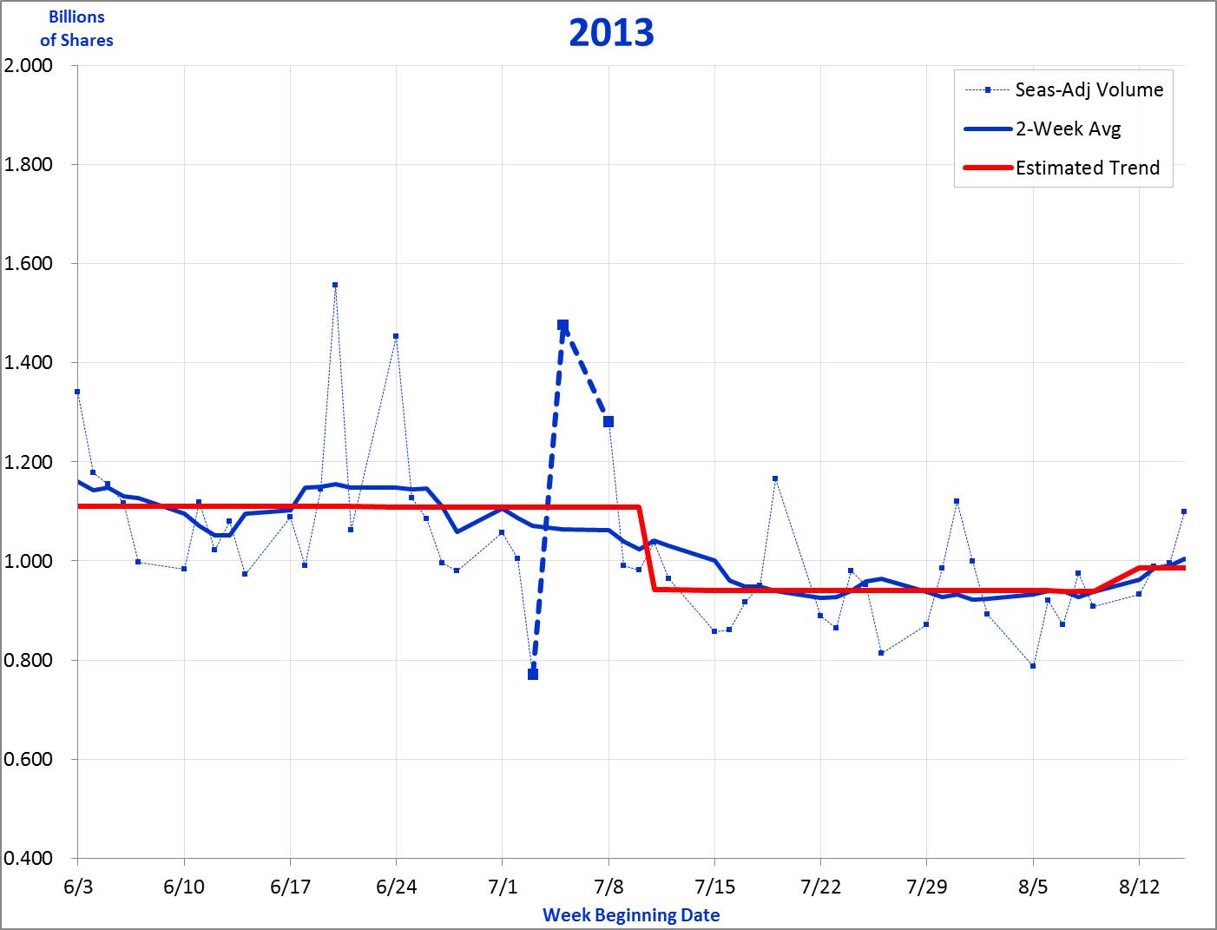
Estimating Trend Daily
Introduction
Model Set-Up
Estimating Trend
Low Factor Adjustments
Key Points
While adjusted sales are still well above trend, they are not nearly as much so as they are without the application of the “Low Adjustment Factor.
Original Adjusted Sales
Proposed Adjusted Sales
DailyTrendModel: 2011
80
8 -
Notes:
In conclusion, we can clearly see that applying a “Low Adjustment Factor” can make a substantial impact on seasonally-adjusted sales for a day where there is a low Combined Factor. The “Proposed Adjusted Sales” are still well above trend, but we can see that there are a couple of days in mid-June that come in slightly higher. So we still see a large value for the day, but not nearly as great as originally.
It should be noted that this adjustment works equally in both directions. If the Actuals for July 5th were very low, the adjusted sales for the day would also be extremely low. Applying the “Low Adjustment Factor” will raise the adjusted sales amount, leaving it still below trend but not nearly as much as it would be without the additional adjustment.

Slide 81
Estimating Trend Daily
Introduction
Model Set-Up
Estimating Trend
Low Factor Adjustments
Key Points
Let’s summarize the key points about estimating daily trend.
Approach similar to Monthly Trend model
Emphasize “events” over “growth”
Avoid too many changes to the trend line
Rely on Monthly Trend analysis for guidance
Minimize actual vs estimate differences
Utilize a low factor adjustment
Be patient
Key Points
81
8 -
Notes:
We’ve now completed describing the approach for estimating trend daily. Let’s summarize the key points about this approach:
The approach is very similar to that used in the Monthly Trend model. As with the Monthly model, it entails “playing” with estimates of the annual growth rate and events to track how the data behaves over time. Similarly, it relies on seasonally-adjusted data, and it displays the running differences between actuals and estimates. On the other hand, there is no “live” tracking and changing of the monthly seasonality. And the tracking of trend relies heavily on a 2-week moving average, (though, depending on how cooperative your data, it may be more appropriate to use a moving average covering a shorter – or possibly longer – length of time).
I recommend most of the adjustments to trend be captured as “events” rather than growth rate changes. You will frequently find that attempts to change growth rates require using values that are incredibly high and often three figures in length (i.e. over 100%). The problem with these high growth rates is that they can be difficult to interpret and understand; what does a 50-100% growth rate mean to a company whose annual sales typically change by 10% or less from one year to another? Also, whenever any change to trend is input, it begs the question, what caused it? How do you explain this x% rise or fall in sales?
Related to the events is the caution that you try to avoid inserting too many changes to the trend line. Every change input calls for an explanation: what caused this change, is the amount of change reasonable, etc. The daily metrics, even after being adjusted for the calendar and seasonality & so on, will inevitably behave with notable & unavoidable volatility. You’ll want to try and resist the desire to pursue some of that volatility.
You will likely find it helpful to rely on the previously done Monthly Trending for guidance. This is definitely a case of “seeing the forest for the trees”, and daily data is definitely about being in the trees. Nonetheless, you need to go there, and track that daily data if you are to understand what is driving your performance. This need especially applies to those organizations in the habit of following daily data, organizations where there truly are major things going on almost every day as is the case in highly competitive industries like telecommunications, for example.
As ever, as you derive your estimated trend line, you want to try to minimize the differences between actuals and estimates. However, do not let this goal force you to input lots of changes to trend so that you can keep the differences as close as possible to zero. Sometimes a small difference of 1-2% (or more) may be a good thing if you are unable to explain the changes it would take to have the trend line fit more closely. If you can’t avoid larger differences however, do try to have the differences offset quickly. So, for example, if you’re high by 2-3% in August, hopefully you find yourself low by a similar amount in September, or by October at the latest.
Be aware of the “Low Factor Adjustment”, an adjustment built into this model to avoid having relatively quiet holidays cause a disproportionately large impact on seasonally-adjusted values. You certainly should consider raising or lowering the 0.50 maximum low factor amount that is in use in this model.
Finally, be patient. I’ve said this before, but this really does apply to the effort to estimate trend on a daily basis. There’s a lot of noise, and there’s a lot of values you’re trying to follow. If you’re open seven days a week, that’s over 1,000 data points in less than 3 years. Always keep in mind the purpose of trending your daily data. You want to keep on top of what’s going on with your performance. You want to learn from your data so you may perform better going forward. And you want to be able to explain and illuminate your performance to senior management. This model can certainly do much to help you with these goals. But you will need to resist the frustration that comes with following “ill-behaved” data. Good luck!

