Slide 1
Chapter 12:
Forecasting
1
12 -
Notes:
We finally turn to the future: forecasting. This chapter will end up being a bit shorter than the others, and perhaps shorter than you might have expected for a topic of this importance. But that’s because, to a large degree, the heavy lifting has already been done.

Slide 2
Forecasting
Introduction
Extrapolate Trend
Modify Trend
Review
The key to successful forecasting can be summed up in eight words:
Your forecasts are as good as your history.
Introduction
2
12 -
Notes:
It’s no exaggeration to state that “your forecasts are as good as your history”. What I mean by that is that so much of your forecasting is dependent on how well you’ve identified where you are “truly” at today, and how much you’ve been able to learn from your past. There is so much critical information to be gathered from your history – insights into what level of impact you might expect from a proposed new product launch, marketing campaign, process change, or whatever. Comparing your proposals with what you’ve done before and the measures you’ve been able to make of your past performance will go far in informing what impact to expect from any projected activity you’re contemplating. Obviously, we don’t know what will happen in future, and history never does precisely repeat itself, but the more knowledge you’ve gained from your past, and the better your defining how you’re doing today, the more likely you’ll succeed at putting together a solid & accurate forecast. And, perhaps more importantly, the better the understanding of your past, present, & future performance, the better position you’ll be in to explain why future results do inevitably deviate from your projections.

Slide 3
Forecasting
Introduction
Extrapolate Trend
Modify Trend
Review
The forecasting process relies heavily on what has already been learned from trending the history.
Extrapolate current trend
Modify trend for growth rate changes & events
Review for reasonableness
3
12 -
Notes:
The steps for the forecasting process are quite simple:
1st, you want to re-examine your trendline with a particular focus on ensuring you’re comfortable with the exact current level you are at, and with the growth rate that is currently in use. After making any modifications to the recent past, you simply extrapolate your current trend, a step that is already automatically performed by the trend model. Next, you modify this projection. You start by examining future growth rates, a step that primarily considers external factors. Then you add in projected events, which will usually be driven by internal activity. Finally, you review the forecast for reasonableness, and consideration of any further tweaking.

Slide 4
Forecasting
Introduction
Extrapolate Trend
Modify Trend
Review
Determining your current level and growth requires close review of your current trendline for potential modification.
Is this at appropriate Level & Growth Rate?
XYZ Model: SalesTrend
4
Extrapolate Trend
12 -
Notes:
To start the review of your current position, we return to the “Trend” tab. And here we will pick up on our earlier example of trending sales for the “XYZ” company, carried out in the “XYZ Model” file.
The review of the current position involves particular focus on where the trendline is at the end of the Actuals period. In this model, March 2017 is the last month for which we have data; the following months are labeled the “Forecast Period” in the chart, and are highlighted with a soft yellow background to emphasize the separation to the forecast period. (And you may recall, the yellow background is used as a way to avoid having even more lines on the chart; i.e. having one line for actuals and another for forecast actuals, one line for past trend and another line for future trend, etc.). The text box highlighted in the figure asks whether the trendline is at the appropriate level and growth rate. Do we want to modify the growth rate of the trendline so that its extrapolation into the future period is at a different slope?

Slide 5
Forecasting
Introduction
Extrapolate Trend
Modify Trend
Review
When considering the current position, particular focus should be on the Growth Rate, for initially this is the rate applied to the entire future period.
Growth Rate is steepened in Sep ‘16, and made flat as of Feb ‘17.
XYZ Model: SalesTrend
5
12 -
Notes:
When considering the current position, one of the most important questions to consider is what you consider the most reasonable estimate of the growth rate for today. Initially, this rate is going to be applied to the entire forecast period. Previously we had a -1.0% growth rate starting in Sep 2016, and continuing through the end of 2018. But given the slight uptick in March, it’s reasonable to modify the growth rate so that is flat (0%) from Feb 2017 forward. Arguably, the growth rate could be made flat from Sep 2016 forward; this is a judgement call. And judgement calls will be inevitably faced in virtually any situation. You’ll never get it absolutely “right”, because you’ll never know exactly what it “should” be. If it gives you greater comfort to apply sophisticated statistical techniques, go to it. Just don’t fool yourself into thinking that those techniques will get it “right”, or even necessarily, more right. What you want to give the most consideration to is that growth rate as you head off into the future. So in this example, does a flat rate seem more appropriate going forward than a slight decline of say -1%?

Slide 6
Forecasting
Introduction
Extrapolate Trend
Modify Trend
Review
The forecast trendline simply extrapolates trend through the entire forecast period; forecast actuals add on the calendar effect & seasonality.
Forecast values apply calendar effect & seasonality to trendline
XYZ Model: SalesTrend
6
12 -
Notes:
With the starting point for the forecast established by tweaking the trendline through the most recent actuals available, we now turn our attention to the forecast itself. The chart displayed here has widened the Y-axis so you can see how high & low the forecast (& historic) actuals run. As you can see, the trendline is extrapolated, and runs at the same pace through the entire Forecast Period. Initially, no events are inserted; we’re just looking at how it runs if the trend is simply extrapolated. The forecast actuals, in grey, have had the calendar effect & seasonality applied. Note that the total forecasts for 2017 & 2018, of approximately 437,000 each year, are highlighted in Cells S52 & T52.
If one wasn’t anticipating any change in the growth rate, and any future events, the forecast would be done! But that’s not likely to be the case. Let’s see about the business of modifying growth & inserting events.

Slide 7
Forecasting
Introduction
Extrapolate Trend
Modify Trend
Review
Changes in the forecast growth rate will often be due to external forces.
Industry growth.
Dependent industry growth (change in auto sales growth would impact auto insurance sales growth).
Outlook for national economy (over & above #1 & #2).
Modify Trend
7
12 -
Notes:
The extrapolated trend has growth set at the rate established at the end of the actuals period. The question then becomes when and to what degree does the growth rate need to be modified over the future period. While certainly not absolute, I’ve found that most of the time adjustments to growth rates are caused by largely external factors. Why? Because we’re talking about factors that prompt an adjustment at a steady ongoing pace, and most of the actions organizations take result in shifts of growth rather than a change of it’s pace.
I’ve outlined here some of the major factors to consider that might change the future growth rate. The 1st is a change in the industry trend. Perhaps you belong to an industry trade group or service that is predicting a general slowdown or uptick in growth for next year. Usually these predictions do not involve shifts in growth, and they are unable to be specific about the timeline. But using their projection as a baseline, you may choose to adjust your growth rate accordingly.
Another potential adjustment to your growth rate may be due to what is occurring in an industry on which you’re dependent. Auto insurance companies should anticipate a slowdown in their sales if the auto industry is predicted to slow down. Ideally, you have calculated a correlation coefficient that measures the degree to which your sales are impacted when the dependent industry sales change – for example, a correlation coefficient of 0.2 would imply that a 10% slowdown in auto sales would lead to a 2% slowdown in your auto insurance sales.
A 3rd factor to consider is the outlook for the national economy. Here again you’re asking yourself the degree to which projected changes in key (to you) economic measures will impact growth of your sales, or any other metric you may be forecasting.
For all three of these factors, it is vital that you avoid double-counting. A slowdown in the national economy is likely to cause some slowdown in your dependent industry which in turn leads to a slowdown in your industry’s trend. You want to capture the net effect of all three. Perhaps the industry trend change is sufficient to capture the net effect to your organization. The point here is to evaluate, as best you can, what is going on in the outside world and to what degree that will likely impact your business. Of course, you also need to consider when to apply the change. To a large extent, the amount and timing of growth rate changes are judgement calls. You should be able to capture and explain your proposed growth rate change.

Slide 8
Forecasting
Introduction
Extrapolate Trend
Modify Trend
Review
Forecast growth rate changes can also be driven by internal factors.
Internal programs or process changes that take more than a few months to roll out.
Slowdown after rollout of major advertising campaign.
Other.
8
12 -
Notes:
Obviously, internal factors can also prompt changes in growth rate, even if not as frequently as the external. Rolling out program or process changes can adjust your growth rate, particularly when these changes take many months to execute. Perhaps you’re introducing a training program that will take a year to execute, and you’re expecting your given metric (say sales) will be 3% higher as a result: you could increase your growth rate by 3% starting with the month that the rollout begins; just be sure to drop it back down 3% at the end of the program.
Another source of a growth rate change is when marketing campaigns prompt an immediate increase in sales, but then see sales drop back down in time, unless new marketing efforts are undertaken to sustain the gain. Lacking the additional efforts, you will want to have growth slow down so that sales return to their previous level, or as close to it as judged appropriate.
Inevitably, there may be other causes for expecting growth to change in future. Perhaps you want to capture expected competitive activity of an unknown or difficult to quantify impact, with an unknown date of arrival – adjusting the growth rate accordingly may be an effective way to address that, and explicitly measure and identify. Or perhaps there’s concern about corporate capacity or any of a number of possibilities that lead you to expect some change in the pace of growth for some specific duration of time.
To sum up, changes in growth can be difficult to estimate because they tend to be more subtle and take place over a longer period of time, so your history may prove less informative when it comes to estimating. The important thing is to consider the growth change possibilities, and to explicitly measure and identify them so that when actual results come in you can review them for potential explanation of differences between actuals and forecast.

Slide 9
Forecasting
Introduction
Extrapolate Trend
Modify Trend
Review
Anticipated changes are inserted in the Growth Rate section of the “Trend” tab.
Growth Rate change in July changes trend line slope
XYZ Model: SalesTrend
9
12 -
Notes:
The figure here displays a change of the growth rate from flat to 1.0%, in July 2017. Perhaps the industry trade group is anticipating a 2% improvement in the industry starting in the summer. You’re not sure that you agree with all of that, nor of how much it will impact your own firm’s sales, but here you decide to at least include half that increase in your own sales, and to apply it beginning in July.

Slide 10
Forecasting
Introduction
Extrapolate Trend
Modify Trend
Review
Some “events” may need to be followed up with a growth rate change.
October marketing campaign bumps sales
XYZ Model: SalesTrend
10
12 -
Notes:
We earlier talked about how you following a major one-time marketing campaign, you may need to insert a growth slowdown get sales back to their former level. Let’s walk through this with an example. Here I’ve posed that you plan some big marketing campaign for October that you anticipate will lift sales by 2.5%. The trendline pops up by the 2.5% inserted in the “events” section (Cell S40).

Slide 11
Forecasting
Introduction
Extrapolate Trend
Modify Trend
Review
Growth may need to be temporarily slowed to return sales back to their prior level, or near their prior level.
January Rate change returns sales near prior level
XYZ Model: SalesTrend
11
12 -
Notes:
Let’s say the campaign is something of a one-time effort. You always have marketing efforts going on, to be sure, but perhaps this particular lift is due to a special TV ad campaign that will run for a couple months; it’s out of the ordinary and costs much more than most of your efforts. In a situation such as this, typically companies will indeed see a big lift when the campaign rolls out, and then there’s a slow but steady return to the level they were at previously. Typically the reversal takes 3-6 months to play out. That’s what we’ve inserted here, where we have growth decline starting in January, about 3 months after the campaign begins, and we have set the rate of decline such that sales are back to their approximate prior level about 6 months later, at which point the original 1% growth rate is re-inserted (Cell T17). Note that the decline is to the level it would have been at had the original 1% growth rate just held steady, without the ad campaign. And note further that I still have the level slightly higher than it would have been without the campaign; it seems reasonable that even after the impact of the campaign has fully played out, sales would be at a slightly higher level.

Slide 12
Forecasting
Introduction
Extrapolate Trend
Modify Trend
Review
Perhaps the most significant modifications to your forecast will be for expected future events.
Price changes.
Marketing campaigns.
Product introductions.
New regulations.
Other.
12
12 -
Notes:
The main driver of changes to your forecasts are likely to be “events” that cause a quick & significant shift in projected volumes. These shifts can be the result of a wide assortment of drivers: Price changes will almost inevitably cause an overnight shift in sales, and attrition. If you’ve estimated your price elasticity by following the procedure described in Chapter 10, or otherwise have determined the elasticity, you can apply it to your projected price change to arrive at an estimate of its impact. Certainly marketing campaigns will shift sales. Here your history should prove very helpful in offering assistance for estimating the likely impact. Product introductions may well prompt a shift: again, reliance on your history will provide useful guidance for an impact estimate. New regulations, from the government, or industry, or initiated yourselves, may well shift some of your metrics – costs or sales or both; here too history will hopefully provide some assistance with your estimate. And there are no doubt numerous other possible events that may cause a shift in your projected metric.

Slide 13
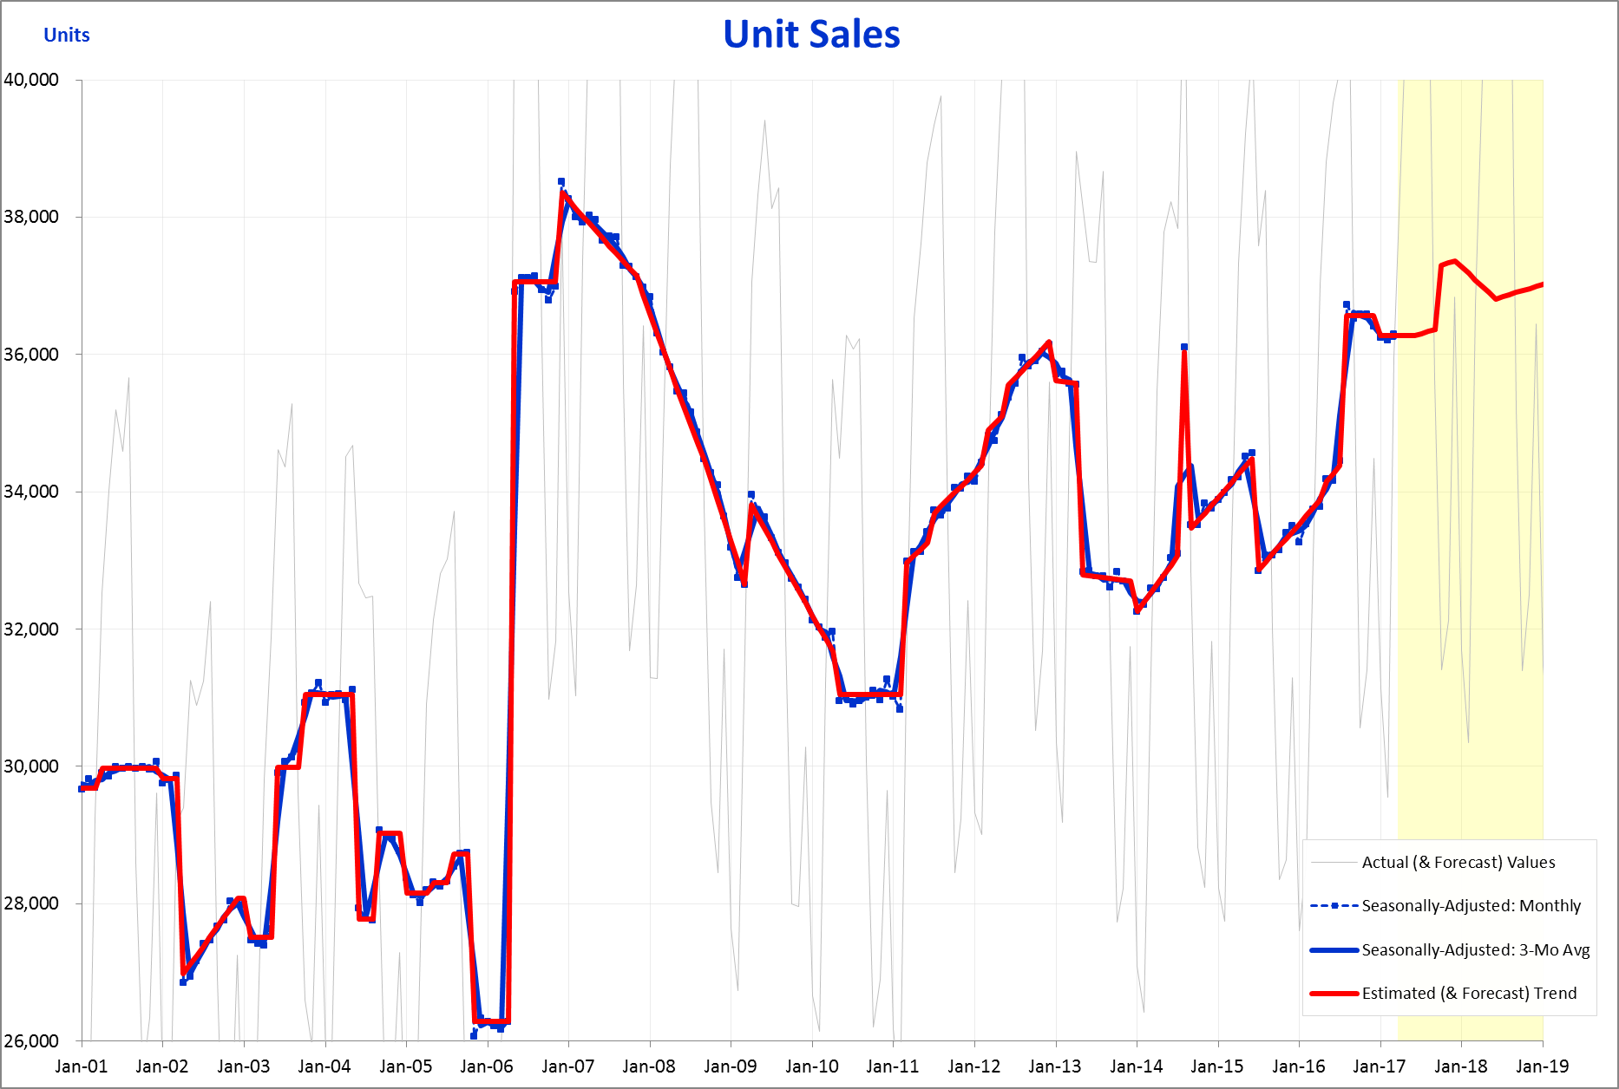
Forecasting
Introduction
Extrapolate Trend
Modify Trend
Review
Review your history for guidance on what impact to apply to a coming event.
Jun ‘03:
New product
+9.0%
May ‘06:
New product;
Mkt’g campaign;
Price cut
+41.0%
Aug ‘16:
New product
+6.0%
XYZ Model: SalesTrend
13
12 -
Notes:
As was stated up front, your forecasts are as good as your history. And if you have successfully analyzed your history, and made appropriate estimates & identifications of past events, you should be well armed to make your forecasts for new projects you may be planning in the coming months. Perhaps your firm is planning on launching a new product line in the middle of next year, and you’re wondering what lift is appropriate to apply. Your history is a good place to start. This figure highlights past product launches for the hypothetical XYZ firm. Unfortunately, they have only introduced major new products on three occasions throughout the 16+ year history. Furthermore, the May 2006 launch coincided with a marketing campaign & a price cut – with these additional activities occurring simultaneously, we will be unable to use this event for isolating the impact of a new product launch alone (though we may be able to roughly guesstimate the distribution of the impact across all 3 activities). For the 2017 product introduction, we really only have these two examples to draw upon. And, as the 1st instance occurred so many years ago, even that will carry less weight. So one would rely heavily on the Aug ’16 launch for guidance on the upcoming one. Hopefully, your history will have more examples than this to draw upon. But even if there is only one clear past event, you still can use it for calibrating an estimate for a future instance. Here you could speak with the department(s) responsible for the product launch to ask them how much more (or less) significant do they think this new launch will be. What factors should enter into their comparison? Your Sales, (& perhaps Marketing) department should be able to provide some guidance as they’ll be more familiar with how the new product in Aug ‘16 influenced the efforts & motivations of the sales force.

Slide 14
Forecasting
Introduction
Extrapolate Trend
Modify Trend
Review
After discussions within your organization, and your examination of past like events, you’re ready to add an estimate of the coming event to your forecast.
Aug ‘18 product launch bumps sales +3.5%
XYZ Model: SalesTrend
14
12 -
Notes:
Once you’ve interviewed the appropriate departments, and given your own estimates of the impact of past events of a similar nature, you should be ready to come up with an estimate of the planned activity. I emphasize “your own” estimates of past events, because often other departments have their own unique perspective, and yes often, that perspective may draw a more positive conclusion regarding the impact of their efforts – quite human. This is where forecasting becomes as much an art as a science. For it is up to you to do your best to gauge what the “true” impact of past events were, as well as to judge how a given future activity will compare. Of course, I’m presuming here that “you” work in the financial analysis area and not in the subject department. You may actually be in the product development area and have been asked to estimate the impact of what your area will be putting together. Hopefully, management will permit you complete objectivity, and you’ll be able to produce your estimate unpressured. Regardless of where in the organization you reside, just do your best to derive an objective figure that you can support, based on your review of the history and your analysis of how the future effort compares.
In our running example, we’ve determined that the new product should have an impact of about 3-4%; not being able to land on one figure or the other, we decide to input an event estimate of 3.5% for August 2018, inserting it in the appropriate cell (Cell T38) in the Events section of the “Trend” tab. The running trend line in the chart jumps accordingly.

Slide 15
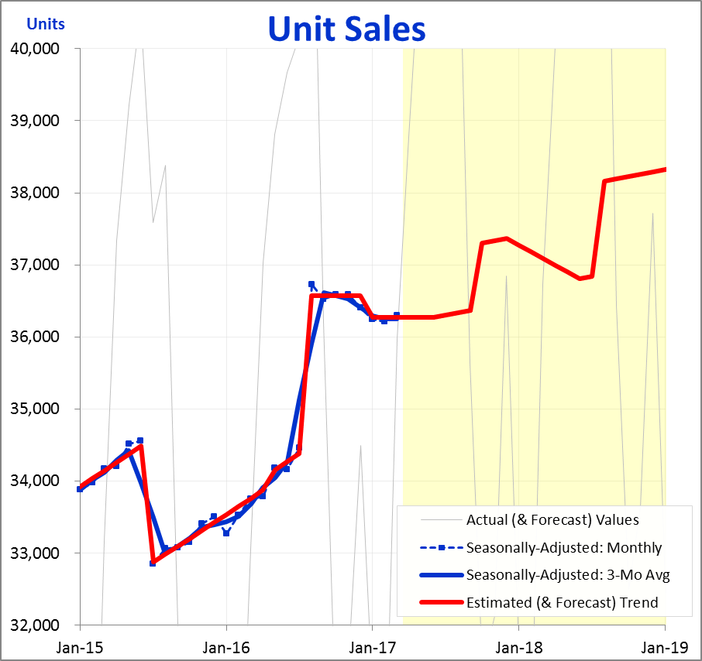
Forecasting
Introduction
Extrapolate Trend
Modify Trend
Review
Once your forecast is complete, you can display the coming events & growth rates on a chart to bring clarity to the driving assumptions.
Jul ‘15:
7% Price Hike
-5.0%
Aug ‘16:
New product
+6.0%
Oct ‘17:
Ad Campaign
+2.5%
Aug ‘18:
New product
+3.5%
Trendline
Jul ‘17 thru Dec ‘18
Growth Rate
+1.0%
XYZ Model: SalesTrend
15
12 -
Notes:
Once you’ve completed your forecast, you can put together a chart that displays all the key drivers of growth (or decline) over the forecast period. The figure here is a simple example of how one might highlight the major events over the forecast period, as well as from the recent past. The trend line is labeled because its behavior is what effectively determines the entire forecast. Underneath the trend line is a text box describing the growth rate assumption over most of the period.
Obviously your forecast may have more elements to it than what are displayed here; I’ve kept this simple for demonstration purposes. Essentially all I’m trying to accomplish here is to display the key drivers of growth over the forecast period, and the assumptions about the change. Management can then take a look at this and decide to what degree they may desire to change those assumptions – and consider if other actions may be warranted to improve the outlook.

Slide 16
Forecasting
Introduction
Extrapolate Trend
Modify Trend
Review
Displaying a good amount of history prior to the forecast helps provide context on recent performance, & info on specific results.
Jul ‘15:
7% Price Hike
-5.0%
Aug ‘16:
New product
+6.0%
Oct ‘17:
Ad Campaign
+2.5% (temp for 6 months)
Aug ‘18:
New product
+3.5%
Trendline
Jul ‘17 thru Dec ‘18
Growth Rate
+1.0%
XYZ Model: SalesTrend
16
Review for Reasonableness
12 -
Notes:
I’ve observed that frequently forecasts only focus on the projected period. They might provide a prior year total figure, but otherwise all tables & charts focus entirely on the forecast itself. I think this is often a mistake, because a full display of recent (& not so recent) past can be extremely helpful for providing context. When management can actually see the slope of growth over the prior two years, see the lifts & drops that occurred as a result of recent identified initiatives, and see by comparison the assumptions about growth and events going forward, they will be in a much better position to make good decisions about the reasonableness of the proposed forecast. It is unavoidable to apply a certain level of intuition and instinct to a future in which no one knows what will happen. A good amount of history will go far to help inform that intuition.
As a rule, I would recommend that the amount of history displayed be as much or more as the length of the forecast period. As example, the forecast period here is for 1 year 9 months (from April 2017 thru Dec 2018), while the past displayed is for 2 years 3 months (from Jan 2015 thru March 2017).

Slide 17
Forecasting
Introduction
Extrapolate Trend
Modify Trend
Review
Annual forecast totals are displayed on the Trend page; consideration of these values is a critical part of the forecast review.
Actual & Estimated Annual totals
XYZ Model: SalesTrend
17
12 -
Notes:
Another key element in any review of your forecast’s reasonableness is to examine what the totals look like for the period. The “Trend” tab displays the annual totals. I leave it to the reader to determine how they wish to display this information; it will likely be consistent with an appearance your organization prefers to use, though again I would consider doing some research on how to optimize the presentation of your results. Such a display will likely include annual percentage changes – for example, that the annual increases here for 2016, 2017, & 2018, are approximately 4.8%, 4.5%, & 2.7%, respectively.

Slide 18
Forecasting
Introduction
Extrapolate Trend
Modify Trend
Review
Another check on the forecast’s reasonability is a comparison of the original extrapolated trend with the final forecast.
Original Extrapolated Trend
Final Forecast
XYZ Model: SalesTrend
XYZ Model: SalesTrend
Comparison of Original Extrapolated Trend and the Final Forecast shows 2017 & 2018 totals are 0.8% & 3.4% higher, respectively.
18
12 -
Notes:
You might recall we started with a simple extrapolated trend, a line that took the level and the growth rate at the last month for which we had actual data, and extended it throughout the entire forecast period. The figure on the left displays that original extrapolation, and has enlarged the estimate totals for 2017 & 2018. The figure on the right displays the final forecast. That final forecast is less than 4,000 higher than the original extrapolation, while the 2018 forecast is about 15,000 higher. These may or may not seem reasonable, depending on the entire situation – how aggressive or modest the extrapolation and the final forecast each seem, the uncertainty surrounding some of the key elements of the forecast, the personality, if you will, of the key decision makers at your organization as to how “optimistic” or “pessimistic” they tend to be, and so on.
It’s useful to bear in mind that the original extrapolated trend is where you started, it’s roughly what you’d anticipate if “nothing happened” over the coming forecast period. Given that as your starting point, how reasonable does it seem to you that your final forecast ends up as it does? If you can feel comfortable with that comparison, you’ve probably got a pretty good forecast.

Slide 19
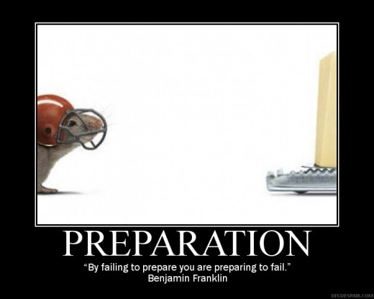
Forecasting
Introduction
Extrapolate Trend
Modify Trend
Review
Forecasting can be a fairly simple & quick procedure, provided you’ve taken the time to prepare a clear & insightful history.
19
12 -
Notes:
By comparison, this chapter is quite a bit shorter than most of those that have preceded it. That might seem surprising given how complicated forecasting can be, and how important. But if you think about it, if you know your history well, then you should have a pretty good of sense of where you’re heading. And you’ll be well positioned to derive reasonable and appropriate estimates for any planned activities you may have going forward. Certainly the forecasting procedure can be much prolonged if there are a host of steps & hoops to jump through to develop a Plan or forecast within your organization. But hopefully you, and others, can come to see that clarity & knowledge about your past will immensely help inform your projections – projections developed with confidence & understanding.

Slide 20
Forecasting
Introduction
Extrapolate Trend
Modify Trend
Review
Seasonally-adjusting your history clarifies how you are doing today, and where you are headed tomorrow.
If you don’t know where you’ve been,
how can you know where you are?
And if you don’t know where you are, how can you know where you’re going?
20
12 -
Notes:
We finish where we began. With an understanding and appreciation of the importance of learning from your history. Seasonally-adjusting that history will clarify how your performance has trended over time. It will highlight when events have occurred, events that you can review to identify the cause and to measure the impact. Understanding your history will help illuminate what actions have succeeded in past, and what have failed. Seasonally-adjusting your history will also enable you to be much more clear about how you are doing today, to identify the approximate level a given metric is at, it’s growth rate, and what recent events may have caused it to shift. By being clear about where you are at today, you are in a much stronger position to speculate on where you’re headed.
If you don’t know where you’ve been, how can you know where you are? And if you don’t know where you are, how can you know where you’re going? I hope that you’ve come to see that the procedure I’ve outlined in these pages provides a powerful way to clarify your past, your present, your future. Using the technique I’ve described here, you’ll be in the driver’s seat, not a sophisticated statistical software program that only a few understand. By being in control of the analysis of your performance over time, you’ll have gained greater understanding from the knowledge that history can provide. And that knowledge, combined with a powerful tool to help clarify how you’re doing, will prepare you well for envisioning & improving the road ahead.

