Slide 1
Part I: Normalizing the Data
1
1 -
Notes:
In the “Overview” presentation, we looked briefly at seasonally-adjusting data as a powerful tool for understanding your performance: past, present, & future. And we looked at some of the issues with the more traditional methods of trending data and evaluating how you are doing.
We’re now going to get into the details of how you seasonally-adjust and trend your data. These details will be divided into two broad parts: in this first part we’ll walk through normalizing the data, the process of adjusting monthly data so each month is of approximately equal length. In the second part, we’ll use the normalized data and develop seasonal factors that allow us to seasonally-adjust the data and have a much easier time of trending the data over time.
Again, as I emphasized in the “Overview”, be aware that all of this describes one approach for seasonally-adjusting your data. What I like about this approach is that it enables you to seasonally-adjust your data yourself: you’ll be in the driver’s seat, using fairly basic Excel formulas to perform the data adjustments. And you’ll understand why the various steps are being taken. Even if you use software that seasonally-adjusts the data for you, I would hope this will enable you to much better understand what that software is doing, or at least, should be doing.

Slide 2
Part I: Overview
The seasonal-adjustment process is laid out below. Seasonal factors are obtained by normalizing the data, then adjusting history for growth & events.
Equated Day Factors (Day of Week)
Seasonally-Adjusted Data:
Initial
Original Data
Normalized Data
Initial Seasonal Factors
Holiday Factors
Growth Rate
(Adjustments)
Seasonally-Adjusted Data:
Initial
Growth-Adj
Seasonal Factors
Seasonally-Adjusted Data:
Final
Events
(Adjustments)
2
1 -
Notes:
The seasonal-adjustment process requires a number of steps that are outlined here in this diagram. You start with your original data and first “normalize” that data so every month is of approximately equal length. To do that, you need to more accurately quantify the length of each month, which is done by calculating “equated day factors” and “holiday factors”. The equated day factors estimate how long each day of the 7-day week is, relative to the daily average. Holiday factors capture how much quieter or busier activity is on holidays and the days immediately preceding & following them. Combining these two sets of factors arrives at the “normalization factors” that are used to normalize the data.
Next, a simple initial set of seasonal factors is quickly calculated, using the normalized data. These initial seasonal factors are used to derive an initial set of seasonally-adjusted history. That history is then trended. The trend estimates describe the growth rates and events over time. The history is adjusted for this historic growth & events, and a final set of seasonal factors obtained. When the final set of seasonal factors and normalization factors are applied to the original data, a final seasonally-adjusted history will be the result.
In this part I, we walk through the process of normalizing the data.

Slide 3
Chapter 1: Normalizing the Data –
Equated Day Factors (EDFs)
or “Day-of-the-Week Factors”
Equated Day Factors (Day of Week)
Seasonally-Adjusted Data:
Initial
Original Data
Normalized Data
Initial Seasonal Factors
Holiday Factors
Growth Rate
(Adjustments)
Seasonally-Adjusted Data:
Initial
Growth-Adj
Seasonal Factors
Seasonally-Adjusted Data:
Final
Events
(Adjustments)
3
1 -
Notes:
So, let’s begin by estimating the equated day factors…

Slide 4
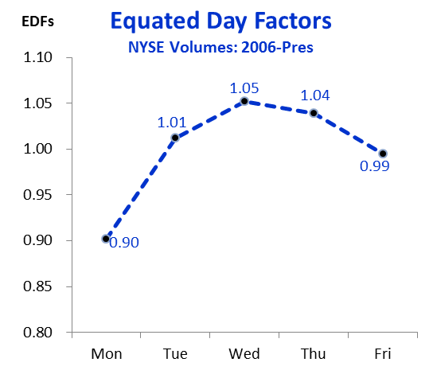
Equated Day Factors (EDFs)
Equated Day Factors (EDFs) are an index of the relative weight of activity for each day of the 7-day week.
4
1 -
Notes:
The Equated Day Factors (or EDFs) describe how busy each day of the week is relative to the daily average. The factors are represented as an index, where 1.00 is the daily average, and each day is characterized as being some percentage above or below that average. Why are these important? Because each month, except for February, has 30 or 31 days, where 2-3 days of the week occur 5 times during the month, while all the other days occur only four. That extra day may be quite significant, depending upon how much the pattern varies across the week. If you are especially busy on Monday, then all else being equal, having 5 Mondays one month and 4 Mondays the next, that 1st month may be 2-3% longer or more, simply due to this one aspect of the “calendar effect”.
The EDF chart here is for the NYSE daily sales volumes from 2006 thru late 2016. Activity is about 10% below average on Monday. The sum of the factors totals exactly 5.00 (yes, the numbers here add to 4.99 but that’s due to rounding). EDFs will always add to exactly the number of days of the week for which there is activity, be it 5 days, or 7 days, or any other figure.

Slide 5
Equated Day Factors (EDFs)
Development of the EDFs involves seven steps.
No. | Action | Description
1 | Collect the data | Pull daily data going back as far as is available, reliable, & useful.
2 | Sort data into weekly format | Setting up the data in Excel to make it easier to conduct the EDF analysis.
3 | Index the data | Express each day’s data as a percentage, or index, of the average day length for that week.
4 | Establish minimum and maximum ranges by setting a maximum allowable number of standard deviations | Each weekday is given minimum & maximum ranges to identify what data is counted, or not. This is accomplished by calculating the standard deviation for each day of the week.
5 | Chart the weekly data | The factors are charted to assist choosing the desired number of standard deviations to be permitted.
6 | Refine ranges by tweaking number of permitted standard deviations | Playing with the allowed number of standard deviations will determine how tight the allowed minimum-to-maximum range will be, and in turn lead to the exclusion of all weeks containing one or more outlier values.
7 | Identify different EDF periods, as needed | If appropriate, it may be necessary to break out the factors for different periods of time where the factors are significantly different.
5
1 -
Notes:
The process for estimating the EDFs involves 7 steps.
The data is collected.
The data is next sorted to enable easy calculation of the EDFs.
Next, an initial set of factors is calculated.
Then we use the standard deviations to weed out those weeks containing outliers we want to remove for purposes of calculating the “normal” EDFs.
The factors are then charted.
The chart helps in tweaking the number of standard deviations to be employed for arriving at the final set of EDFs for a given time period.
The last step involves repeating this exercise for other time periods, then reviewing the results to determine if there may be one or more overall averages that apply to the entire history.

Slide 6
Equated Day Factors (EDFs)
Collect data
Sort data
Index data
Set Min-Max
Chart data
Refine ranges
Identify periods
The data used to develop Equated Day Factors, and Holiday Factors, will ideally have the following attributes:
Go back in time as far as you can; 20-25 years gives you about 3 years of data for developing Christmas holiday factors.
Reliable.
Usable (values not too small, & volatile).
1. Collect Data
6
1 -
Notes:
So, the 1st step in calculating the EDFs is to collect the data. This may be one of the most important steps: not just for calculating the EDFs, but for analyzing and learning from your history overall.
I would strongly urge you to go as far back in time as possible. You’ll want the data to be more or less reliable. And you won’t want values being so small that there is an inordinate amount of volatility, as can be the case when working with smaller numbers.
Even though your organization may be quite different today as compared to time past, there may still be key pieces of information you can glean from your past that could be beneficial – the impact of unusual natural or political events; estimating your price elasticity; determining what kinds of practices have been more or less successful historically, etc. Most of the analytical work is in setting up the calculations. Whether you do so for two years or for twenty will not make that much difference. Again, you may find some interesting info from your past that would have gone neglected if you took a shortcut and failed to go back very far in time. And by going back much further in time you can derive more accurate measures of your holiday factors – to be examined in the next chapter. Ideally, you can go back about 25 years. Going back that far will enable you to get at least 3 sets of data for each of the 7 days of the week that a fixed date holiday can fall. This can be quite valuable for analyzing the most difficult, and generally most important holiday of the year – Christmas.

Slide 7
Equated Day Factors (EDFs)
Collect data
Sort data
Index data
Set Min-Max
Chart data
Refine ranges
Identify periods
What if you have no daily data – do you just skip this procedure? NO.
Talk with appropriate staff at your organization and attempt to derive crude estimates of the relative weight for each day.
Do the same with holiday factors.
Goal: Fill in the template.
7
1 -
Notes:
What if you have no daily data? What if all your history is presented in monthly form only? You still should endeavor to estimate your EDFs, for you still want to express all monthly data in roughly equal-length months. To do this you will want to fill in the form here, inserting rough approximate estimates of how relatively busy each day of the week is. I would recommend sitting down with a couple of other people in your organization and walking through how busy each day is. Ideally you can gather folks from the appropriate area: sales managers for sales data, accountants for revenue data, and so on.
Sit down and come up with a number representing roughly how busy you are on the “average” Monday: maybe you express it as 100, or perhaps it’s a rough guess of the actual figure, say 12,400, or whatever. OK, if Monday is 100, or 12,400, how busy is Tuesday, then Wednesday, and so on, through the rest of the week. Then add up the total for the week and express each day as a percentage of the daily average. If you’re open all 7 days, and you have Monday at 100 and the week total is 750, then Monday’s factor would be 7 x 100 / 750 = 0.93. I would round each number to the nearest 1/100th, for these are crude estimates at best – just make sure the factors total to the given number of days that you have activity.
By the way, you will then want to repeat this exercise for holiday factors – to be described later.

Slide 8
Equated Day Factors (EDFs)
Collect data
Sort data
Index data
Set Min-Max
Chart data
Refine ranges
Identify periods
The dataset used here as example will be the 1991-2016 New York Stock Exchange (NYSE) sales volume data.
Publicly available.
Daily.
Goes back to 1900.
Behavior “should be” understandable
Using volumes, not prices.
Data Source:
http://www.nyxdata.com/nysedata/asp/factbook/viewer_edition.asp?mode=table&key=3000&category=3
8
1 -
Notes:
For the purposes of demonstrating how to estimate EDFs specifically, and how to seasonally-adjust data generally, I have chosen to use the data showing sales volumes for the NYSE. I chose this data for a number of reasons: it’s publicly available, so I didn’t have to go through what can be a difficult exercise of inventing data, or using some organization’s specific data and “altering” it in order to hide information they want kept confidential. Other advantages of the NYSE data is that it’s daily data so we can use it for demonstrating the estimation of equated day factors & holiday factors. It goes back all the way to 1900 so we have plenty of history to draw upon – don’t worry, I only am using data going back to 1991. Because we’re dealing with data that is so broadly known as the NYSE, another advantage here is that one doesn’t have to be an “insider” to evaluate and understand at least some of what might be driving the data behavior we observe. Finally, I should point out that we will be using volume data, not closing index amounts. It’s doubtful that we would find much difference in prices across the week, or at holidays, etc. If we did, the whole world would soon know about it and the pattern would quickly vanish.

Slide 9
Equated Day Factors (EDFs)
Collect data
Sort data
Index data
Set Min-Max
Chart data
Refine ranges
Identify periods
To sort the data so it can be easily analyzed for developing EDFs, we want the data in columns, where each column is one of the 7 days of the week.
Data Sorting Goal:
Data in columns
2. Sort Data
9
1 -
Notes:
Once the data is pulled, we want to sort the data into columns, with each column being a different day of the 7-day week.

Slide 10
Equated Day Factors (EDFs)
Collect data
Sort data
Index data
Set Min-Max
Chart data
Refine ranges
Identify periods
Data sorting starts with the original data: this set is downloaded from NYXData website.
Table 1.2
NYSE Daily Data: OrigData
10
1 -
Notes:
We start the data sorting process by looking at the original dataset. Three things to point out here. 1st, there is data for “group shares”, “group trades”, and “group dollar volume”. This is the format the data comes in when you download it from the NYXData website. We will focus on just the group shares, in Column B.
The second thing to note is that many days are missing. The exchange was closed on January 1st, for the holiday, and on Jan 5th & 6th for the weekend, and so on. This is how data will be: there will likely always be some days that are “absent” from the dataset. Nonetheless, we will want to fill those absent days with a “0” so that we can easily apply formulas that will sort the data properly for us.

Slide 11
Equated Day Factors (EDFs)
Collect data
Sort data
Index data
Set Min-Max
Chart data
Refine ranges
Identify periods
Note the NYSE volumes have many days “missing”, when the exchange was closed.
NYSE Daily Data: OrigData
11
1 -
Notes:
The second thing to note with this data is that many days are missing. The exchange was closed on January 1st, for the holiday, and on Jan 5th & 6th for the weekend, and so on. This is how data will be: there will likely always be some days that are “absent” from the dataset. Nonetheless, we will want to fill those absent days with a “0” so that we can easily apply formulas that will sort the data properly for us.

Slide 12
Equated Day Factors (EDFs)
Collect data
Sort data
Index data
Set Min-Max
Chart data
Refine ranges
Identify periods
One starts with the original data: the NYSE volumes have many days “missing”, when the exchange was closed.
NYSE Daily Data: OrigData
NYSE Daily Data: OrigData
12
1 -
Notes:
Finally, I want to point out here how I label where the given table or chart is found amongst the files located on the “MakingApples” website. The labels will always have two parts: the 1st part will be the file name, the 2nd part will be the tab. Thus, this Original Data example is drawn from the “NYSE Daily Data” file, under the “OrigData” tab.

Slide 13
Equated Day Factors (EDFs)
Collect data
Sort data
Index data
Set Min-Max
Chart data
Refine ranges
Identify periods
The next step in sorting the data is to have placeholders for every day of the year, & to identify the day of the week, and the week & month of the year.
NYSE Daily Data: DataByDay
13
1 -
Notes:
The next data sorting step is performed on a different tab, to make it cleaner and easier to keep straight. Here I have listed in Column A every day for the entire period being examined (in this instance, from Dec 31, 1990 thru the end of 1995). I picked up Dec 31 because it falls on the Monday, and I want to sort all daily data into weeks, with the weeks described in terms of the date for the Monday starting their week. I’ve manually entered “Mon” thru “Sun” in Column B, cells B11-B17 to be exact. Cell B18 simply picks up the value from cell B11. That formula is then copied for the rest of the 5 year period – it’s that simple. Similarly, in Column C, cell C11 picks up the date (here it’s Dec 31, 1990). C12 thru C17 picks up that same date, for we want every day of the week to be described as falling in the week of Dec 31, 1990. Then, in Cell C18, we simply put the formula “+C11+7”, which gives us the Jan 7, 1991 date. Again, we then simply copy that formula all the way down for the rest of the 5-year period. Column D has a formula to identify the calendar month that the given date falls in; this will enable us to later easily calculate the totals by month if we want to.
Finally, Column E uses an “Index/Match” formula to pick up the values from the “OrigData” tab. This formula construction enables us to ensure we get “0” values on those days where no activity occurred.

Slide 14
Equated Day Factors (EDFs)
Collect data
Sort data
Index data
Set Min-Max
Chart data
Refine ranges
Identify periods
The final data sorting step uses Excel “array formulas” to set out all the data by week, with separate columns for each of the 7 days of the week.
NYSE Daily Data: SortDOW
14
1 -
Notes:
The final sorting step, performed on a different tab, is to use “array formulas” to pull in the data by week, and by Day of Week. If you’ve never used array formulas before, I highly recommend you’re doing a little research on how they work. They are very powerful, quite commonly employed, and fairly easy to master. They allow you to perform all manner of calculations in just one basic formula. Here I inserted a formula in Cell B11 that pulls in the volume data from the “DataByDay” tab, with the instructions that the “Week of” date matches the date in Col A, and the Day of the Week matches the days in Row 10. The formula is copied thru the rest of that 1st week, then copied down thru all the remaining weeks, through 1995. A weekly total is calculated in Col I.
We’re now done with sorting the data and are ready to calculate the EDFs.

Slide 15
Equated Day Factors (EDFs)
Collect data
Sort data
Index data
Set Min-Max
Chart data
Refine ranges
Identify periods
Next, we index the data, calculating daily factors that represent how each day compares with the average for the week.
EDF: EDF9195
3. Index Data
15
1 -
Notes:
Now that the data is all sorted properly, in a new file (called “EDF” here), we pull in the data from our “NYSE Daily Data” file. To keep the numbers smaller and easier to work with, I’ve expressed the numbers in millions, performed here by multiplying each day’s value by the “Unit” inserted in Cell I1. The “Unit” here is 1/1 millionth, or 0.000001. Note that this cell is displayed with a bright yellow fill. Anywhere that has a yellow highlight represents a place where a manual entry may or may not be necessary; everything else in the spreadsheet is just formula – no additional work required.
The 1st date in the data section (Cell A11) is highlighted – the 1st Monday’s date is entered here; formulas take care of all the other weeks. The rest of this Daily Sales Volume section simply picks up the data from the other file. Section 2, the Daily Factors section, expresses each day’s volume as a percentage of the average daily volume for that week. For the outlined week of Jan 14, the week total was 906 million, for about a 181 million daily average. Monday’s volume of 120 million is about 66% of that average. The Daily Factors for every week always total the “Total Number of Days of the Week”, “5”, which is referenced by formula that picks up the value placed in the highlighted Cell R1.

Slide 16
Equated Day Factors (EDFs)
Collect data
Sort data
Index data
Set Min-Max
Chart data
Refine ranges
Identify periods
For this entire 5-year set of data (1991-95), we also calculate the simple average factors for each day of the week.
EDF: EDF9195
16
1 -
Notes:
At the top of section 2, a set of simple average factors are calculated; they are the average for the entire 5-year period, for each day of the week. Monday comes in quite low, at 0.84.

Slide 17
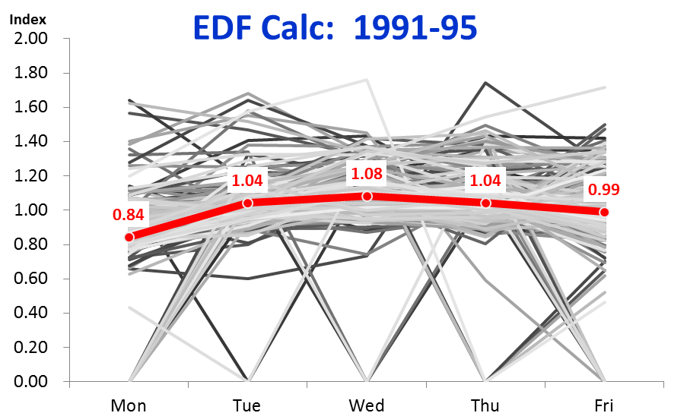
Equated Day Factors (EDFs)
Collect data
Sort data
Index data
Set Min-Max
Chart data
Refine ranges
Identify periods
What do all these daily factors look like? The chart shows most are in a fairly tight range, but there are numerous outliers.
Outliers
Simple Average
Outliers
17
1 -
Notes:
So what do all these factors look like? The chart shows that most of the data comes within a fairly narrow range. Most of the values for Monday, for example, come in between 0.60 and 1.20, though there are numerous occasions where the values are below or above that range. But there are many “outliers”, values that are well outside the “norm”. The most obvious outliers are where the factor is “0’, those days where the NYSE was obviously closed. Many of the closed days fall on Monday, not surprising as many holidays (Memorial Day, Labor Day, Presidents Day), fall on a Monday (ML King Day was not established as a holiday until 1998).
There are also a number of outliers on the high side. We don’t want to pick up those weeks where there are outliers – not only is the value unusually low or high for the day of the outlier, but then the other days of the week will be correspondingly higher or lower than normal because of the outlier day(s). Is there an easy way to rid ourselves of these outliers?

Slide 18
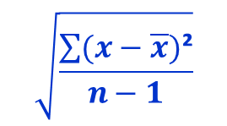
Equated Day Factors (EDFs)
Collect data
Sort data
Index data
Set Min-Max
Chart data
Refine ranges
Identify periods
How do we get rid of these outliers? We will want to keep data within a range, as expressed in terms of standard deviations.
$$\sqrt{\frac{\sum{(x−\overline{x})\text{²}}}{n−1}}$$
The formula for the standard deviation is:
4. Set Min & Max
18
1 -
Notes:
Use of statistical formulas is kept to a minimum with the seasonal adjustment methodology that I’ve developed. I have intentionally kept formulas simple to enable one to easily understand what’s going on. The main exception to this rule here will be the use of standard deviations.
The standard deviation is a measure of how volatile the underlying data is; it captures how much the data varies from the mean, or average. The more widespread the data, the higher the standard deviation. In our dataset, Monday appears to be more diverse than Wednesday for example, so we will expect it to have a higher standard deviation.
How do we use standard deviations to whittle down our data and remove the outlier weeks? By evaluating each data point to determine if it falls within a given number of standard deviations from the mean.

Slide 19
Equated Day Factors (EDFs)
Collect data
Sort data
Index data
Set Min-Max
Chart data
Refine ranges
Identify periods
We let Excel calculate the standard deviations for each day, over the 5 years.
EDF: EDF9195
19
1 -
Notes:
At the top of the Daily Factors section, we’ve inserted a formula for each day of the week which calculates the standard deviation. As expected, Monday’s standard deviation (0.28), is higher than Wednesday’s: 0.17.

Slide 20
Equated Day Factors (EDFs)
Collect data
Sort data
Index data
Set Min-Max
Chart data
Refine ranges
Identify periods
The next step is crucial: for each day, we calculate how many standard deviations from the mean they are.
EDF: EDF9195
20
1 -
Notes:
The next step is key: we calculate how many standard deviations each day’s value is away from its mean. In the highlighted example, Monday, Dec 31, 1990’s daily factor is 1.09. 1.09 is 0.25 higher than Mondays’ mean of 0.84. 0.25 is 90% (0.25/0.28) of the Monday’s standard deviation of 0.28: “0.9” is shown in the highlighted Cell T11. The same calculation is performed for all the days of the period.
Note the colorful conditional formatting in this Section 3. I wanted to bring attention to how close or far each day is from its mean. And I have done so by using the criteria that is set up at the top of this section. Days that have low standard deviations, defined here as being anything less than 1, are highlighted in green. Days with a very high standard deviation count were defined as being above 2, and are highlighted in orange. Days that fall between 1.5 and 2.0 standard deviations are highlighted in pink, while those between 1.0 and 1.5 have no fill. Just like that, we can quickly see how well “behaved” the data is each day and each week.

Slide 21
Equated Day Factors (EDFs)
Collect data
Sort data
Index data
Set Min-Max
Chart data
Refine ranges
Identify periods
We determine which weeks to allow, and which to eliminate, by setting a “Maximum Number of Standard Deviations” to allow.
EDF: EDF9195
21
1 -
Notes:
The next step determines whether or not we are going to “count” a given week. In highlighted Cell AC4, we have entered a value of “1.0”. This value represents the maximum number of standard deviations we will allow in order for a day and week to be counted. If the number of standard deviations from the mean for a given day and week are less than the 1.0, it will be counted; if not, it won’t.

Slide 22
Equated Day Factors (EDFs)
Collect data
Sort data
Index data
Set Min-Max
Chart data
Refine ranges
Identify periods
We then evaluate each day of each week, and we only count those weeks where every day came within the maximum standard deviations allowed.
EDF: EDF9195
22
1 -
Notes:
In Column AC, a formula is inserted, and copied down, that asks of each day of that week, whether or not the number of standard deviations from the mean is less than the maximum number permitted, as defined in Cell AC4. We can quickly see (thanks to the colorful formatting) that the only week meeting this criteria is the week of Jan 21, 1991. It’s is the only week where every value in Section 3 is “green”, is less than the 1.0 maximum. Accordingly, that week has a “1” in Column AC, the other weeks displayed here do not.
Notice that the count of the allowed weeks is summed at the top of Column AC, in Cell AC1: of the 261 total weeks over this 5-year time period, 185 met the standard deviation criteria, and were counted.

Slide 23
Equated Day Factors (EDFs)
Collect data
Sort data
Index data
Set Min-Max
Chart data
Refine ranges
Identify periods
Our Final set of Equated Day Factors pick up only the weeks that are counted, that meet the Maximum Standard Deviation criteria.
EDF: EDF9195
23
1 -
Notes:
Section 4. of the “EDF” tab picks up those weeks that meet the criteria. The highlighted week of Jan 21 picks up the Daily Factors from Section 2; the other weeks displayed here have zeroes. The “Final EDFs” section is filled by simply multiplying the Daily Factors from Section 2, by the “Count?” value in Column AC.

Slide 24
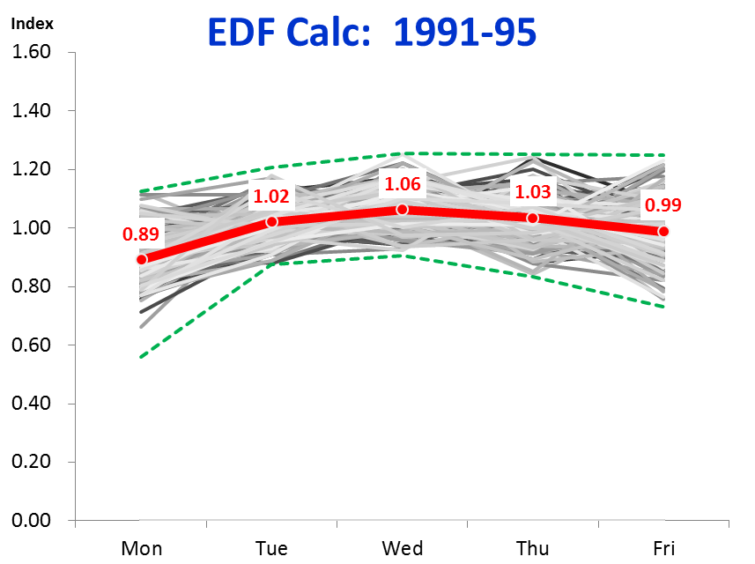
Equated Day Factors (EDFs)
Collect data
Sort data
Index data
Set Min-Max
Chart data
Refine ranges
Identify periods
So what does this look like? The chart displays the outcome where the weeks counted all have factors within 1.0 standard deviations of the mean.
+ 1.0 Standard Deviations
EDF’s
- 1.0 Standard Deviations
EDF: EDF9195
5. Chart Data
24
1 -
Notes:
We earlier noted that 185 weeks met the 1.0 standard deviation criteria. What do those weeks look like? Our chart here shows us. The new set of Average Daily factors (or EDFs) is highlighted. Note that Monday’s average has increased a bit – from 0.84 to 0.89; getting rid of all those “0” values helped increase it. The “band” shows the range within which each day had to fall in order for that day and week to be counted.

Slide 25
Equated Day Factors (EDFs)
Collect data
Sort data
Index data
Set Min-Max
Chart data
Refine ranges
Identify periods
If we increase the Maximum Standard Deviation criteria to 2.0, many more weeks get counted.
EDF: EDF9195
6. Refine Ranges
25
1 -
Notes:
We originally set the maximum standard deviation criteria to 1.0. What happens if we increase that value? Here we have increased the value in AC4 from 1.0 to 2.0. As you can see, many more of the weeks are counted. Note that the total weeks counted has increased from 185 to 220 (Cell AC1).

Slide 26
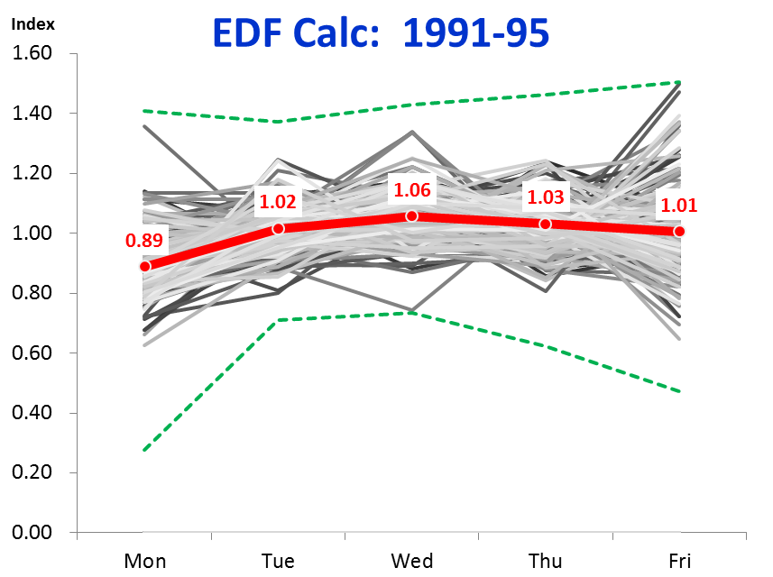
Equated Day Factors (EDFs)
Collect data
Sort data
Index data
Set Min-Max
Chart data
Refine ranges
Identify periods
If we broaden the net, and allow up to 2.0 Standard Deviations, more weeks are picked up, with a notable concentration of higher values on Friday.
+ 2.0 Standard Deviations
EDF’s
- 2.0 Standard Deviations
EDF: EDF9195
26
1 -
Notes:
The chart here shows the impact of broadening our net to 2 standard deviations. More weeks are picked up. Look at Friday: only a few lower values are picked up, but there are quite a few higher values on Friday. Not surprisingly, the average factor for Friday has increased – from 0.99 to 1.01.

Slide 27
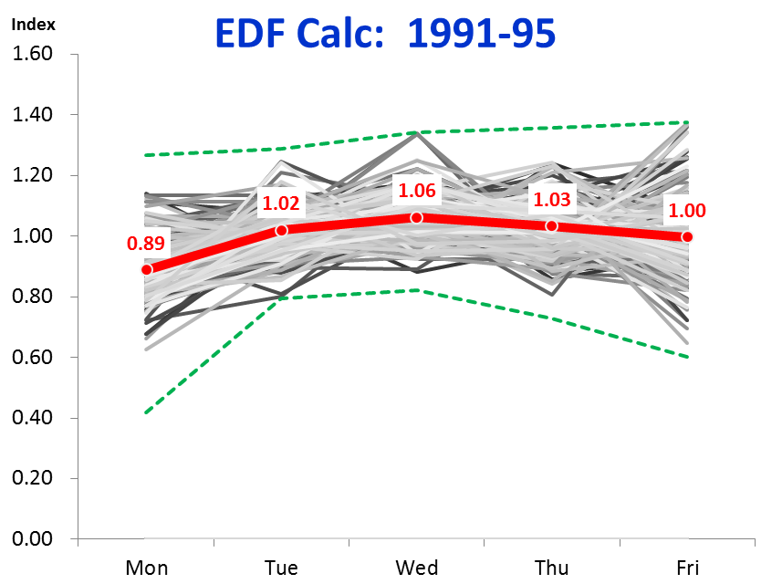
Equated Day Factors (EDFs)
Collect data
Sort data
Index data
Set Min-Max
Chart data
Refine ranges
Identify periods
The Maximum Standard Deviations to allow is a judgement call, and does not have to be a whole number. Here we “compromise” at 1.5.
+ 1.5 Standard Deviations
EDF’s
- 1.5 Standard Deviations
EDF: EDF9195
27
1 -
Notes:
There is nothing sacred about the maximum standard deviation value being a whole number. Indeed, I generally like to use “1.5” as a nice compromise value. Statistics will tell you that a standard deviation of “1” picks up about 68% of the values, while “2” standard deviations pick up 95%. 1.5 happens to pick up about 87%. Here we are applying this rule to each day of the week, and requiring all 5 days meet the criteria, so the numbers work out to be a bit less. But you get the idea.
The number of standard deviations that is used is very much a subjective decision. There is no one right value. I’ve generally found “1.5” works pretty well when I “eyeball” the data and decide where I want the axe ultimately to fall. This chart here for the EDFs looks pretty good. We’re not quite as top-heavy on Friday, so it’s average slightly drops back, to 1.00, still above the 0.99 we had with 1 standard deviation. The other days look pretty clean as well. Wednesday has a couple of values right by the max – but there are a few lower values to help offset it.

Slide 28
Equated Day Factors (EDFs)
Collect data
Sort data
Index data
Set Min-Max
Chart data
Refine ranges
Identify periods
A comparison of the resulting Equated Day Factors shows they are all very similar, except for the Simple Average.
EDF: Charts
28
1 -
Notes:
I’ve added a chart here to show how the different criteria work out. You don’t need to do this ordinarily; I’m doing this here to help show what kind of difference it makes to “play” with the maximum standard deviation criteria. As you can see, all 3 lines, using 1.0, 1.5, & 2.0 standard deviations, are all very similar. Friday sees the widest range of result; the other days hardly change at all.
The biggest difference is from our original factors, where all data was allowed. The low Monday value is notable, along with a correspondingly higher amount for Tuesday thru Thursday. Observing this comparison, I feel all the more comfortable settling with the 1.5 standard deviation criteria.

Slide 29
Equated Day Factors (EDFs)
Collect data
Sort data
Index data
Set Min-Max
Chart data
Refine ranges
Identify periods
Equated Day Factors are calculated for the other 5-year periods since 1991.
EDF: EDF9600
7. Identify Periods
29
1 -
Notes:
We now calculate the EDFs for all the other 5-year periods. This is NOT a daunting task. I timed myself, and it took me literally 15 minutes to create the other 5 time periods and to tweak the standard deviation criteria. All you need to do is:
Copy the tab (EDF9195) and change the tab name.
Change the title in Cell A1.
Change the 1st Monday date in Cell A11.
Change the formula in Cell B11 so it picks up the correct amount for the 1st day of the covered period.
Copy B11 thru the rest of the period (basically to the Range B11:F271).
That’s it. Almost.

Slide 30
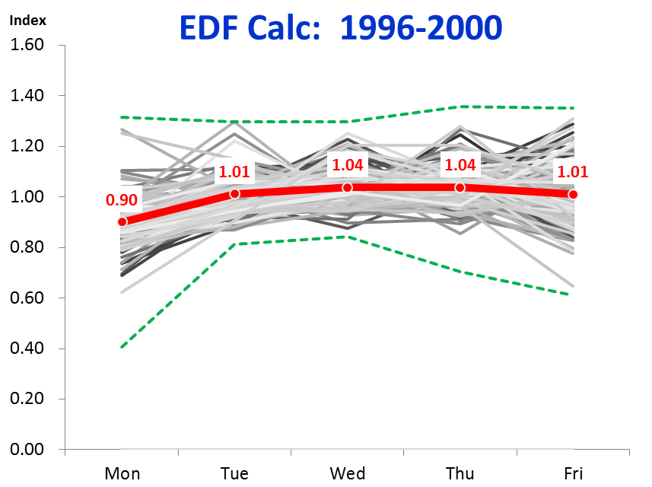
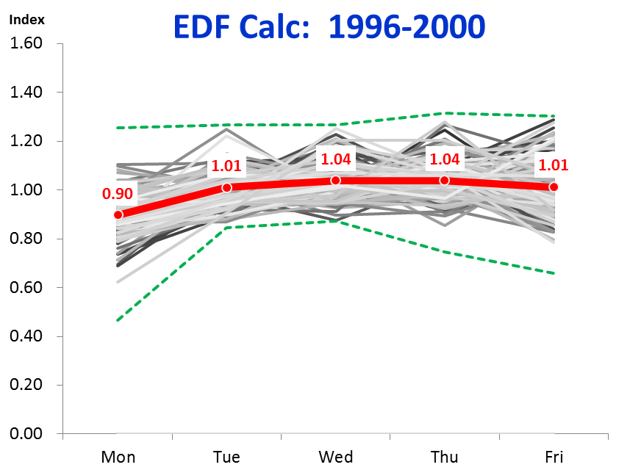
Equated Day Factors (EDFs)
Collect data
Sort data
Index data
Set Min-Max
Chart data
Refine ranges
Identify periods
“Tweaking” the maximum standard deviation value can help eliminate some dangling outliers.
1.5 Maximum
Standard Deviations
1.3 Maximum
Standard Deviations
EDF: EDF9600
EDF: EDF9600
30
1 -
Notes:
You should always check out what the data looks like. For instance, when you look at the chart for the 1996-2000 time period, you’ll note there are a few dangling outliers that are almost on their own. This is where “playing” with the standard deviation count can be useful. Again, this is very much a judgement call, but I like the outcome better when I use 1.3 as the maximum. The 4 highlighted outliers are removed by making this change. Note that the averages hardly change at all – in fact, rounded to the nearest hundredth they remained the same. You only see a change when rounding to the thousandth.

Slide 31
Equated Day Factors (EDFs)
Collect data
Sort data
Index data
Set Min-Max
Chart data
Refine ranges
Identify periods
Equated Day Factors are calculated for every 5-year period. The pattern is much flatter across the week in the recent 2011-15 period.
2011-15
2016-Pres
1991-95
2001-05
EDF: Charts
31
1 -
Notes:
As mentioned, EDFs are calculated here for every 5-year time period. As you can see, they did change a bit over time for the NYSE volume data, most notably in the 2011-15 timeframe.
How many different time periods should you check with your data? Again, this is something of a judgement call. I would try to at least have 1-2 years for a time period range, unless there is a distinct change in pattern going on and you want to narrow the time period to see if you can determine exactly when that change took place – which, by the way, should give you a helpful clue in answering the important question of why it changed.
(I’m not showing it here, but I did look more closely at the NYSE history and found the pattern seemed to start flattening around 2007 – that made sense, for that was about when the Great Recession began, and sales volumes increased enormously.)
I would recommend trying to split out your history into perhaps 3-5 time periods. This will help give you some sense of how the pattern changes over time.

Slide 32
Equated Day Factors (EDFs)
Collect data
Sort data
Index data
Set Min-Max
Chart data
Refine ranges
Identify periods
The general pattern has changed somewhat over the years, with the last decade seeing activity spread more evenly across the week.
EDF: Charts
32
1 -
Notes:
If you wanted, you could stop here. But I like to see if it’s appropriate to further summarize the history, to see if a very similar pattern applies to more than one period, and to summarize the broader time period accordingly. Again, this is a judgment call; it is very difficult to anticipate what types of pattern changes you may see over time.
But I noticed for the NYSE sales volumes, for the earlier history from 1991 thru 2005, there was a similar pattern, with Mondays generally quieter than later periods, and Wednesdays relatively busier. So I averaged those three time periods. I then averaged from 2006-forward, putting much less weight on the final period as it only had data for the 1st 9 months of 2016. Notably, the 2016 pattern is much more similar to the earlier 1991-2005 pattern. This would be worth keeping an eye on, for if it continues for another 6-12 months or more, it would merit capturing this final period separately.
Why call this out? Because the latest set of average factors will be the EDFs we will want to use when it comes time to forecast. But in the meantime, the 2006-Pres seems to represent a good set of EDFs for forecasting purposes.
This completes the estimation of the factors for the day of the week. Next, we turn to the holidays…

